Slide 2
BMO ETF Based Mutual Funds
Easy to Use, Cost Effective Solutions
Edward Ku
Director, Mutual Fund Distribution – GTA North
BMO Global Asset Management
Ashley Francis
Mutual Fund Distribution – GTA North
BMO Global Asset Management
For advisor use only.

Slide 3
BMO Global Asset Management

Slide 4
Speaker’s Bio
Edward Ku
Director, Intermediary Distribution
GTA North
BMO Global Asset Management
Edward is a graduate of Concordia University (BComm) 1997 and has successfully completed level 1 of the CFA program.
He has over 24 years of experience in the financial services industry. For the last 19 years of his career Edward has been working with advisors in Central Ontario to grow their businesses.
Responsible for BMO Mutual Funds, BMO ETFs and BMO Segregated Funds
For Advisor Use Only

Slide 5
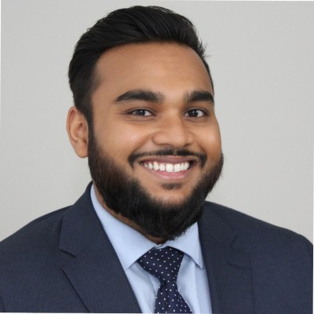
Speaker’s Bio
Ashley Francis
Inside Wholesaler, Intermediary Distribution
GTA North
BMO Global Asset Management
Ashley is a graduate of York University with a major in Economics.
He has over 8 years of experience in the financial services industry. For the last 5 years of his career. Ashley has been working with advisors in Central Ontario to help them get, keep and grow their business and assist their end investors in achieving their financial goals.
Responsible for BMO Mutual Funds, BMO ETFs and BMO Segregated Funds
For Advisor Use Only

Slide 6
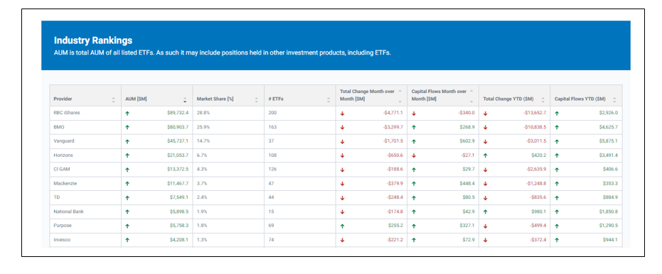
Canadian ETF Landscape

Slide 7
The BMO Advantage
For advisor use only.

Slide 8
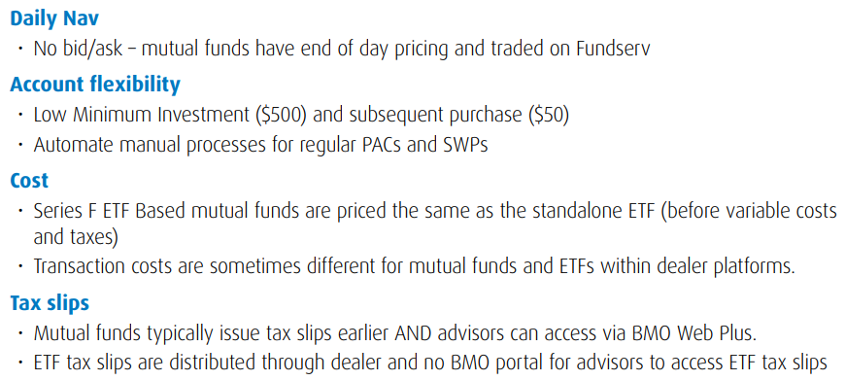
ETF Based Mutual Funds; Same but Different
For advisor use only.

Slide 9
Suites of ETF Based Funds
For advisor use only.

Slide 10
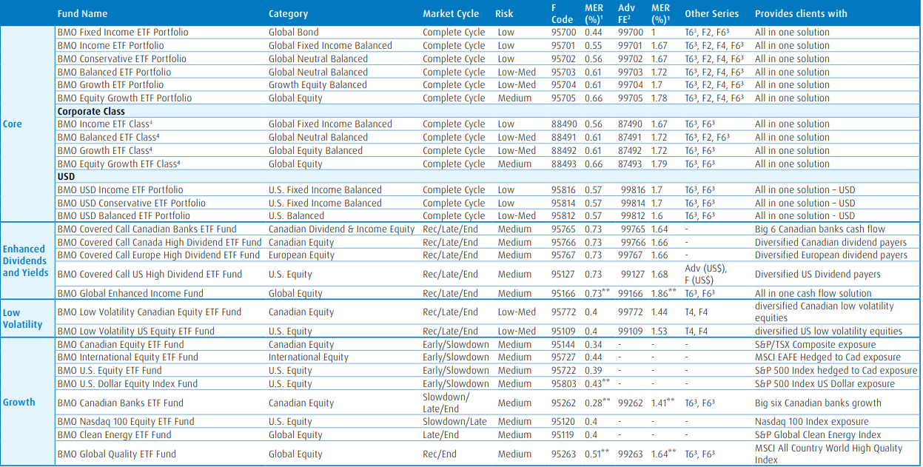
BMO ETF Based Funds
For advisor use only.

Slide 11
Questions?

Slide 12
Disclaimers
FOR ADVISOR USE ONLY. No portion of this communication may be reproduced or distributed to clients as it may not comply with Sales Communications requirements. NOT FOR DISTRIBUTION TO INVESTORS.
Commissions, management fees and expenses (if applicable) all may be associated with investments in mutual funds and ETFs. Trailing commissions may be associated with investments in certain series of securities of mutual funds. Please read the ETF facts, fund facts or prospectus of the relevant mutual fund or ETF before investing. The indicated rates of return are the historical annual compounded total returns including changes in share or unit value and reinvestment of all dividends or distributions and do not take into account sales, redemption, distribution or optional charges or income taxes payable by any securityholder that would have reduced returns. Mutual funds and ETFs are not guaranteed, their values change frequently and past performance may not be repeated.
For a summary of the risks of an investment in BMO Mutual Funds or BMO ETFs, please see the specific risks set out in the prospectus of the relevant mutual fund or ETF . BMO ETFs trade like stocks, fluctuate in market value and may trade at a discount to their net asset value, which may increase the risk of loss. Distributions are not guaranteed and are subject to change and/or elimination.
BMO Mutual Funds are offered by BMO Investments Inc., a financial services firm and separate entity from Bank of Montreal. BMO ETFs are managed and administered by BMO Asset Management Inc., an investment fund manager and portfolio manager and separate legal entity from Bank of Montreal. ®/™Registered trademarks/trademark of Bank of Montreal, used under licence.
Risk is defined as the uncertainty of return and the potential for capital loss in your investments. Risk tolerance measures the degree of uncertainty that an investor can handle regarding fluctuations in the value of their portfolio. The amount of risk associated with any particular investment depends largely on your own personal circumstances including your time horizon, liquidity needs, portfolio size, income, investment knowledge and attitude toward price fluctuations. Investors should consult their financial advisor before making a decision as to whether this Fund is a suitable investment for them.
Series F units are only available to investors who participate in eligible wrap programs or flat fee accounts with their registered dealers that have entered into a Series F Agreement with BMO Investment Inc.
Any statement that necessarily depends on future events may be a forward-looking statement. Forward-looking statements are not guarantees of performance. They involve risks, uncertainties and assumptions. Although such statements are based on assumptions that are believed to be reasonable, there can be no assurance that actual results will not differ materially from expectations. Investors are cautioned not to rely unduly on any forward-looking statements. In connection with any forward-looking statements, investors should carefully consider the areas of risk described in the most recent simplified prospectus.
Minimum initial investment for all funds is $500. This material is for information purposes. The information contained herein is not, and should not be construed as, investment, tax or legal advice to any party. Particular investments and/or trading strategies should be evaluated relative to the individual’s investment objectives and professional advice should be obtained with respect to any circumstance. Commissions, trailing commissions (if applicable), management fees and expenses all may be associated with mutual fund investments. Please read the fund facts or prospectus of the relevant mutual fund before investing. Mutual funds are not guaranteed, their values change frequently, and past performance may not be repeated. Distributions are not guaranteed and are subject to change and/or elimination. For a summary of the risks of an investment in BMO Mutual Funds, please see the specific risks set out in the prospectus. ®/™Registered trademarks/trademark of Bank of Montreal, used under license.

