Slide 1
Subhastin Kharag, CFP
Regional Sales Manager GTA
skharag@equitable.ca
416.902.4669

Slide 2
The Dream Team

Slide 3
Choose Equitable Life
We work for you
Broad competitive product shelf
Underwriting made easy
Regional support in the field where you need it
Online advisor tools
YOU
Brent
Swatuk
Bryan
McNulty
Subhastin
Kharag
The Dream Team
Giuliano
Savini
COLLABORATION

Slide 4
Canadian life insurance sales
Sales by premium as at December 31, 2020
Source: 4th Quarter 2019 LIMRA Canadian Individual Life Insurance Sales

Slide 5
markets
1 – Family protection
2 – Business protection
3 – Tax needs at death
4 – A lasting gift for children
5 – Estate transfer
6 – Retirement planning
7 – A unique asset class
8 – Accessing cash value
Notes:
As you can see, there are many applications where whole life could be a great solution. Let’s take a closer look at each of them.

Slide 6
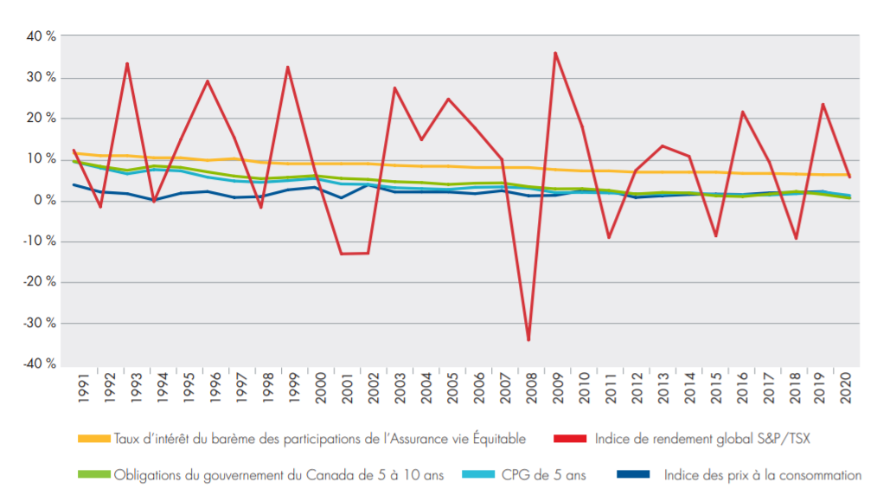
dividend scale interest rate 30-year historical performance
Sources: Statistics Canada, Bank of Canada, Equitable Life of Canada. Data as of December 31 each year. Historical results are not indicative of future performance.
Notes:
The historical dividend scale interest rate compares favourably to other well-known economic indicators.

Slide 7
Why a whole life policy for a child?

Slide 8
Automation makes it easier to do business with us
EZ Upload
E-signature and delivery
EZcomplete online application

Slide 9
Benefits of a Mutual Company
 | Opportunity to share in the earnings in the participating account |  | Voting rights
 | Our focus is on prudent long-term growth, continuity and stability – no shareholder pressures for quarterly results |  | We believe our mutual status allows us to provide better levels of service than a publicly traded company
Notes:
Equitable Life of Canada is one of Canada’s largest mutual life insurance companies.
Opportunity to share in the earnings in the participating account
Voting rights
Our focus is on prudent long-term growth, continuity and stability – no shareholder pressures for quarterly results
We believe our mutual status allows us to provide better levels of service than a publicly traded company.

Slide 10
Subhastin Kharag, CFP
Regional Sales Manager GTA
skharag@equitable.ca
416.902.4669

