Slide 2
Acknowledgement:
Our Team who organized this amazing event…
Sharen Skene and her team including Maria Flores, Jorge Ramos, Robert Garcia, Sarah Sanchez
Our valued Sponsors

Slide 3
Platinum
Gold
Silver
Bronze

Slide 4
Platinum
Gold
Silver

Slide 5
ADD LOGOS
Fidelity Investments
CI Global Asset Management
BMO Financial Group
Mackenzie Investments
NCM Investments
Beneva
Canada Life
iA Financial Group
Equitable Life
Canada Protection Plan (CPP) & Foresters Financial
TD Asset Management
Equitable Bank
Ivari
Manulife
Manulife Bank
Broadridge
Salesforce
Life Design Analysis

Slide 6
Our
Independent Advisors
Thank you for choosing Carte as your MGA and Mutual Fund Dealer

Slide 7
Our Vision
To be Canada’s #1 choice for
Technology, Experience and Freedom
for Advisors, Clients and Employees

Slide 8
Our Mission
To provide an advanced platform for our independent advisors

Slide 9
Core Values
Trust
Integrity
Care

Slide 10
Company Statistics
# of advisors growth 68% (majority are insurance advisors)
Sales growth 15%
MGA – CRMI sales 22 %
Mutual Fund – CWMI 11 %
# of Canadians served increased by 31%

Slide 11
Carte Achievements
in 2022 to date…

Slide 12
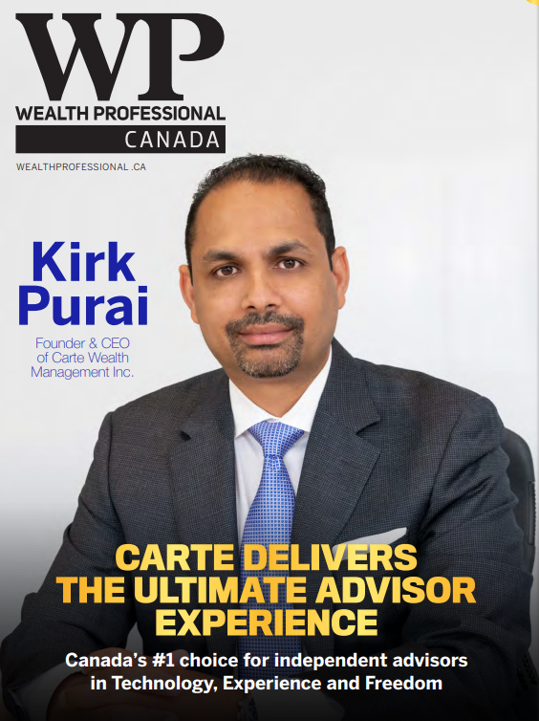
Diversity, Equity and Inclusion

Slide 13
Canada’s Fastest Growing Brokerage
In 2022

Slide 14
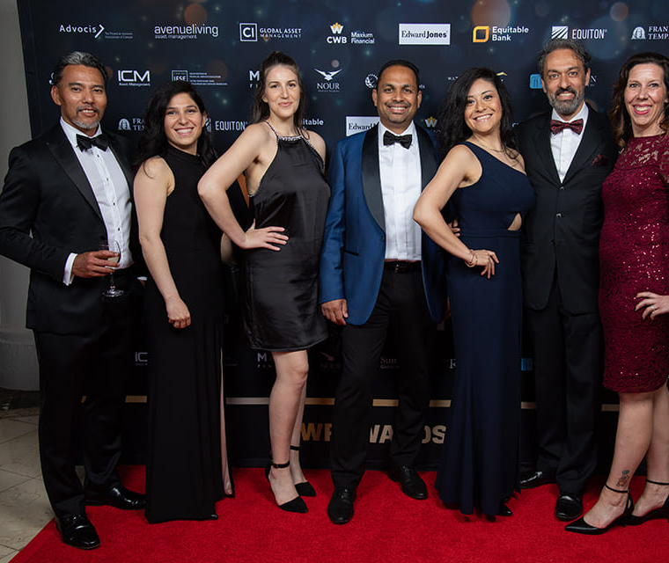
Team Spirit – Attended WP Awards 2022

Slide 16
Thank you Team Carte and our Independent Advisors.
We are driven to deliver the Ultimate Advisor Experience.
WE DID IT…AGAIN!!

Slide 18
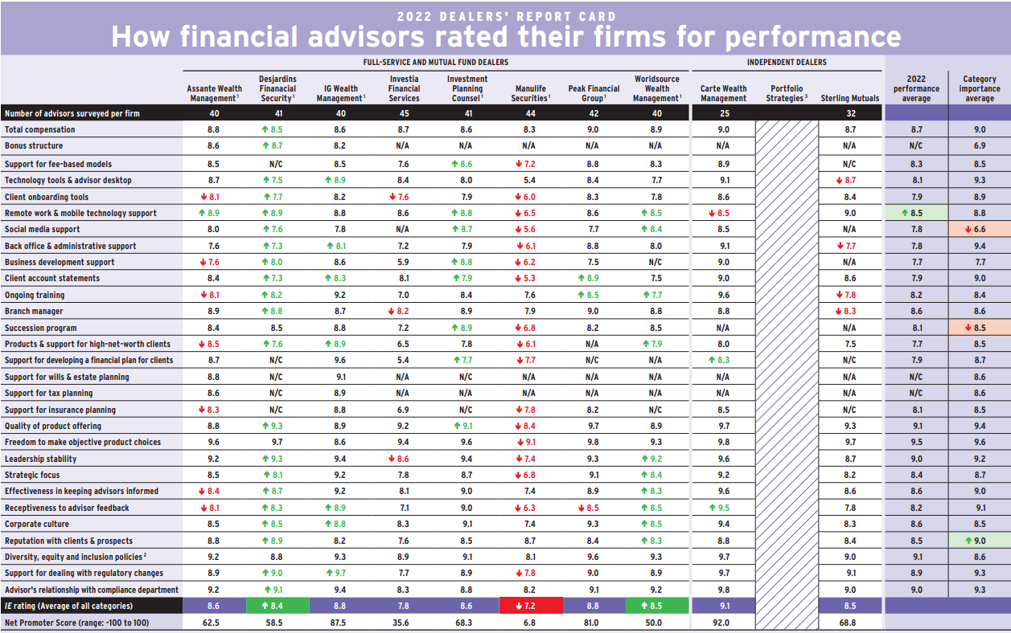
2022
2021

Slide 19
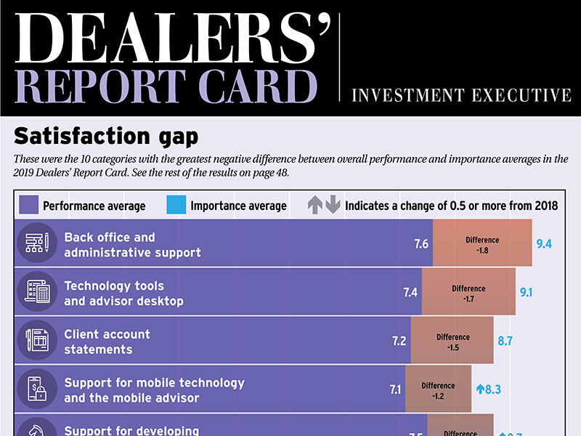
# 1 in 76% of the categories
# 1 in 19 out of the 25 categories
# 1 Four years in a row

Slide 20
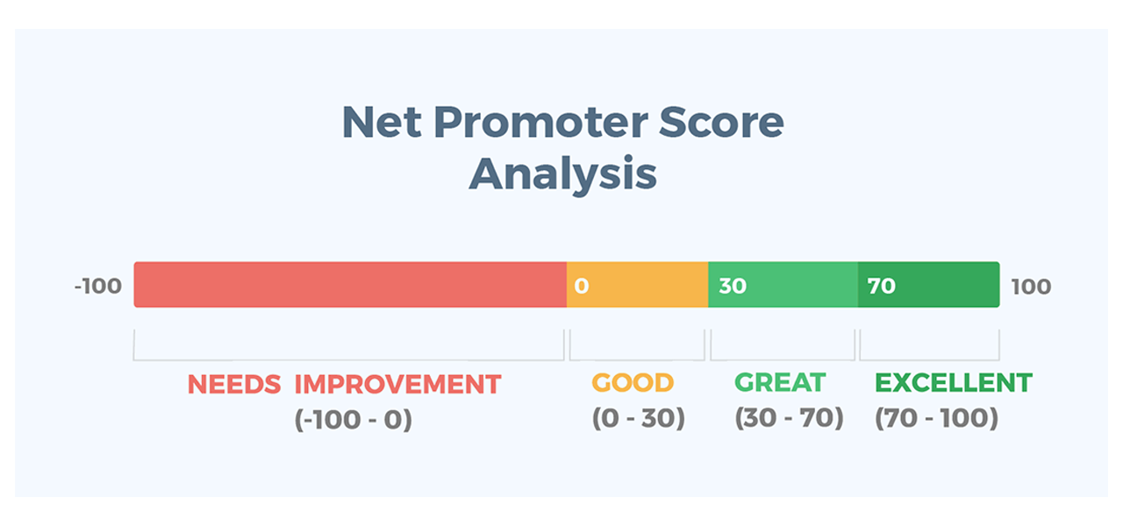
Net Promoter Score measures customer experience and predicts business growth.
Net Promoter Score is rated
from -100 to +100
Carte’s Net Promoter Score
2022 = 92.0 and 2021 = 86.7

Slide 22
What’s Next for our Next Fiscal Year ending September 2023:
Carte Membership Program

Slide 23
The Value of Advice
Here’s why it matters…

Slide 24
Our Purpose…
Why
What
How

Slide 25
Introducing… Maria Flores

