Slide 1
Marketing

Slide 2
Our NEW and IMPROVED
Digital Marketing Packages
Turn-key website, customized to advisor’s brand
Improved social media presence
Automated content using Advisorstream
Trackable analytics
White Glove support service (teach & troubleshoot)
Variety of packages to choose from

Slide 3
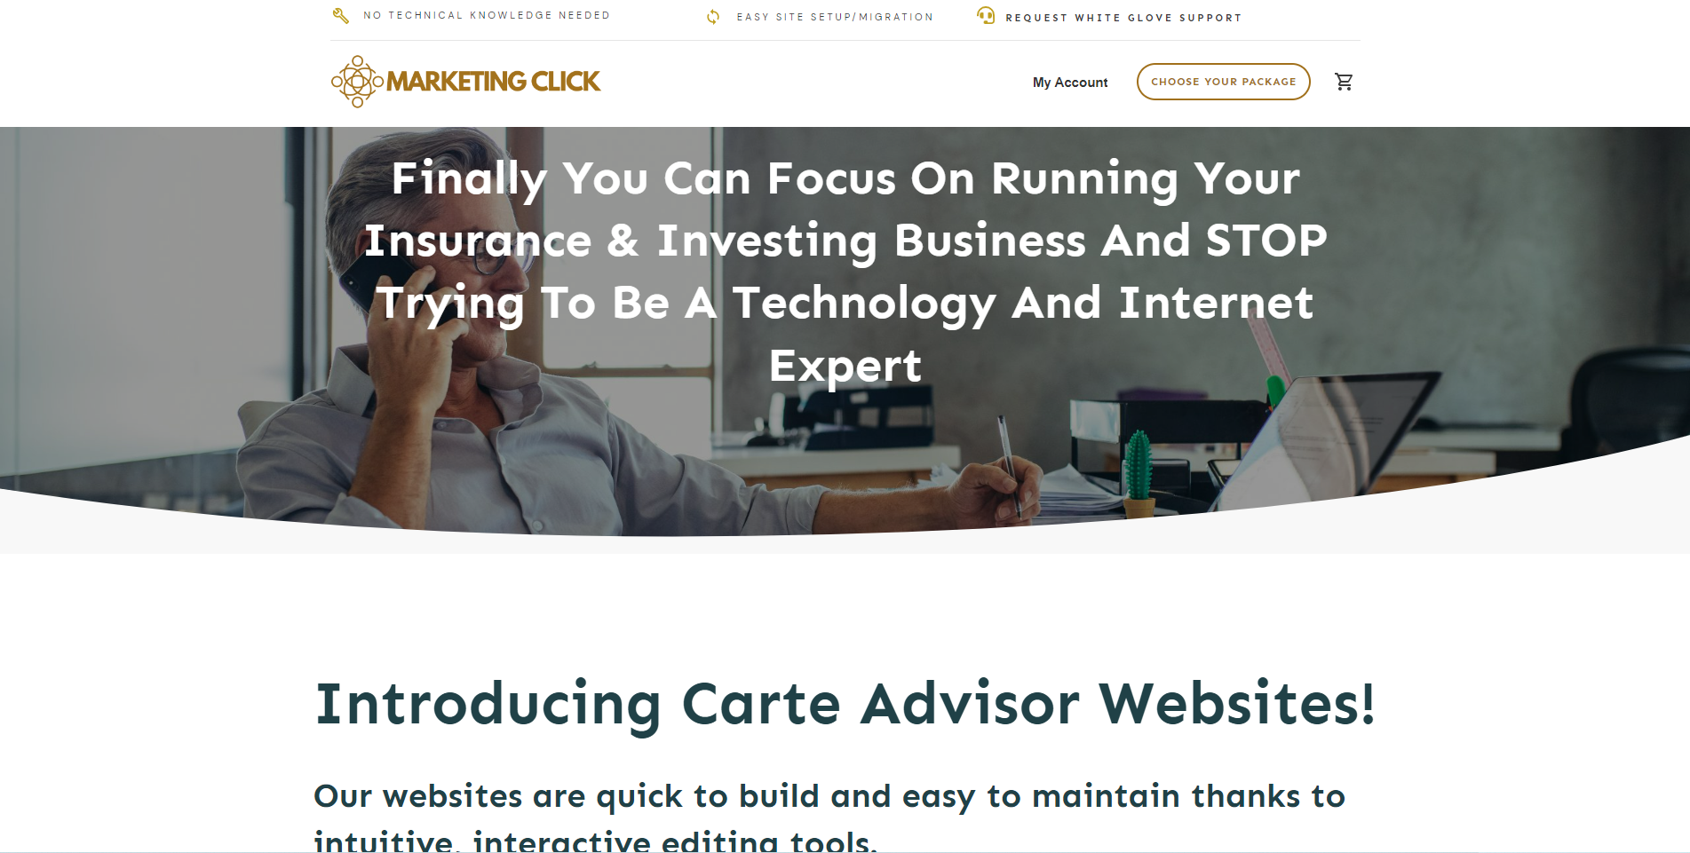
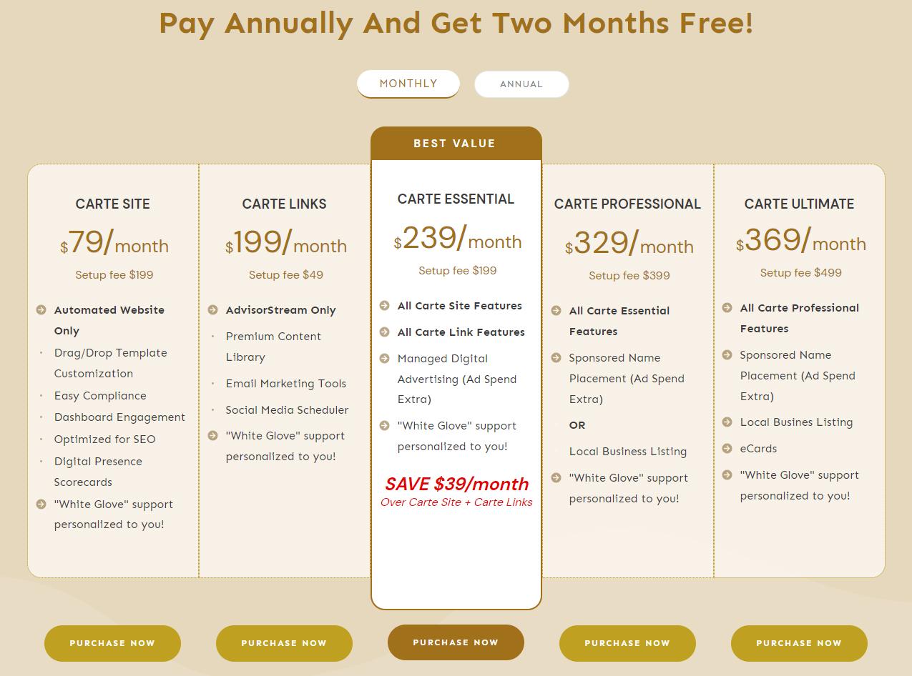
MarketingClick.ca
Just a click away to choose your Digital Marketing Package

Slide 4
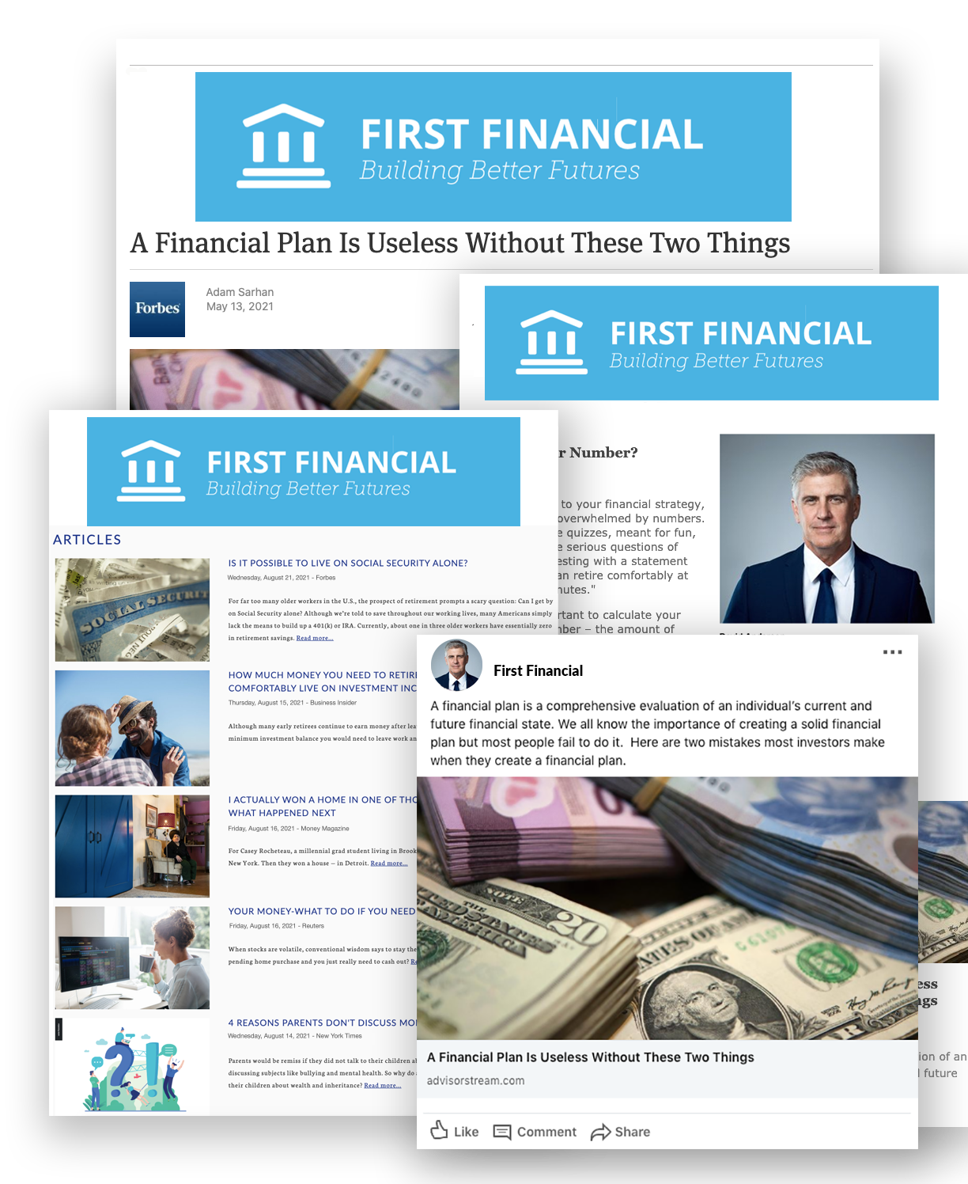
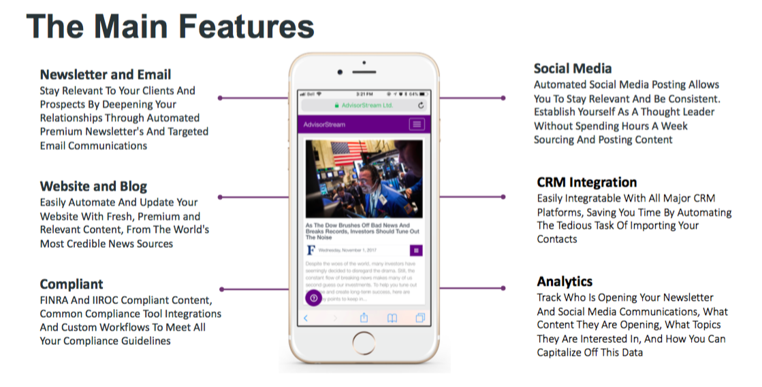
Newsletter & Email
Social Media
Website & Blog
CRM Integration
Compliant
Analytics

Slide 5
Technology

Slide 6
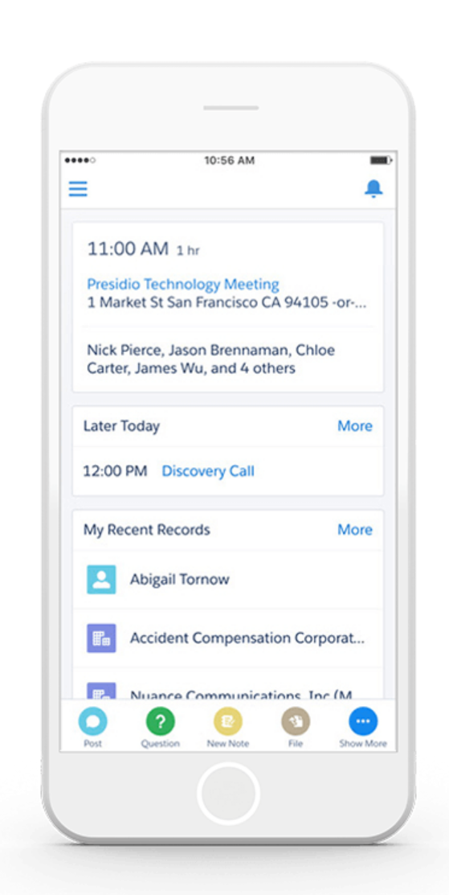
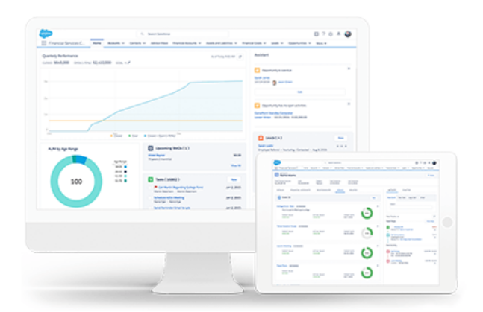
Unify the financial services experience and unlock loyalty

Slide 7
Carte + SalesForce
Connect everything around the customer
Get a bird's-eye view of who your customers are, what financial products they have, and what they need to achieve their life goals.
Connect your entire institution across channels, geographies, and lines of business on Financial Services Cloud.

Slide 8
Carte + SalesForce
Unlock unprecedented customer loyalty
View goals, accounts, life events, policies, and investments to proactively reach out to customers when opportunities arise.
Connect your entire institution across channels, geographies, and lines of business on one financial management software.

Slide 9
Carte + SalesForce
Achieve value faster than ever before
Leverage purpose-built industry functionality with best-practice analytics and prebuilt processes specific to financial services.
Stay ahead of market disruptors with perpetual and relevant innovation from Financial Services Cloud.

Slide 11
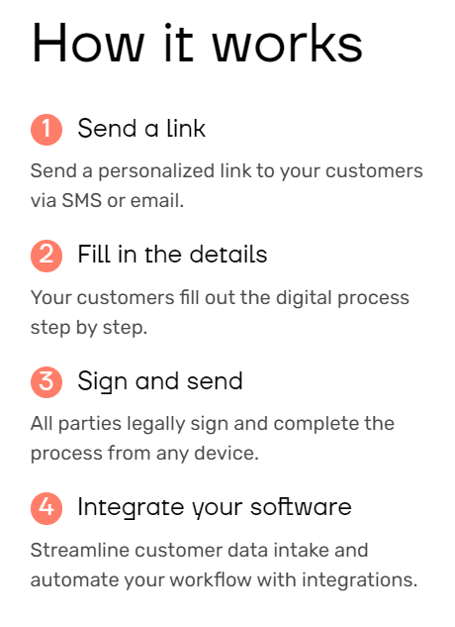
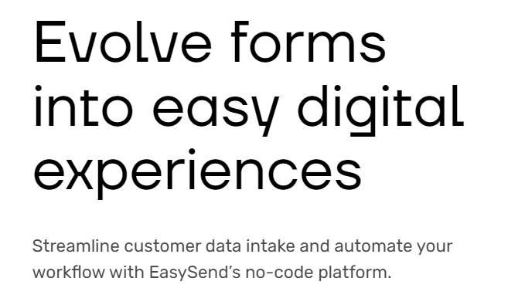
Carte + EasySend

Slide 12
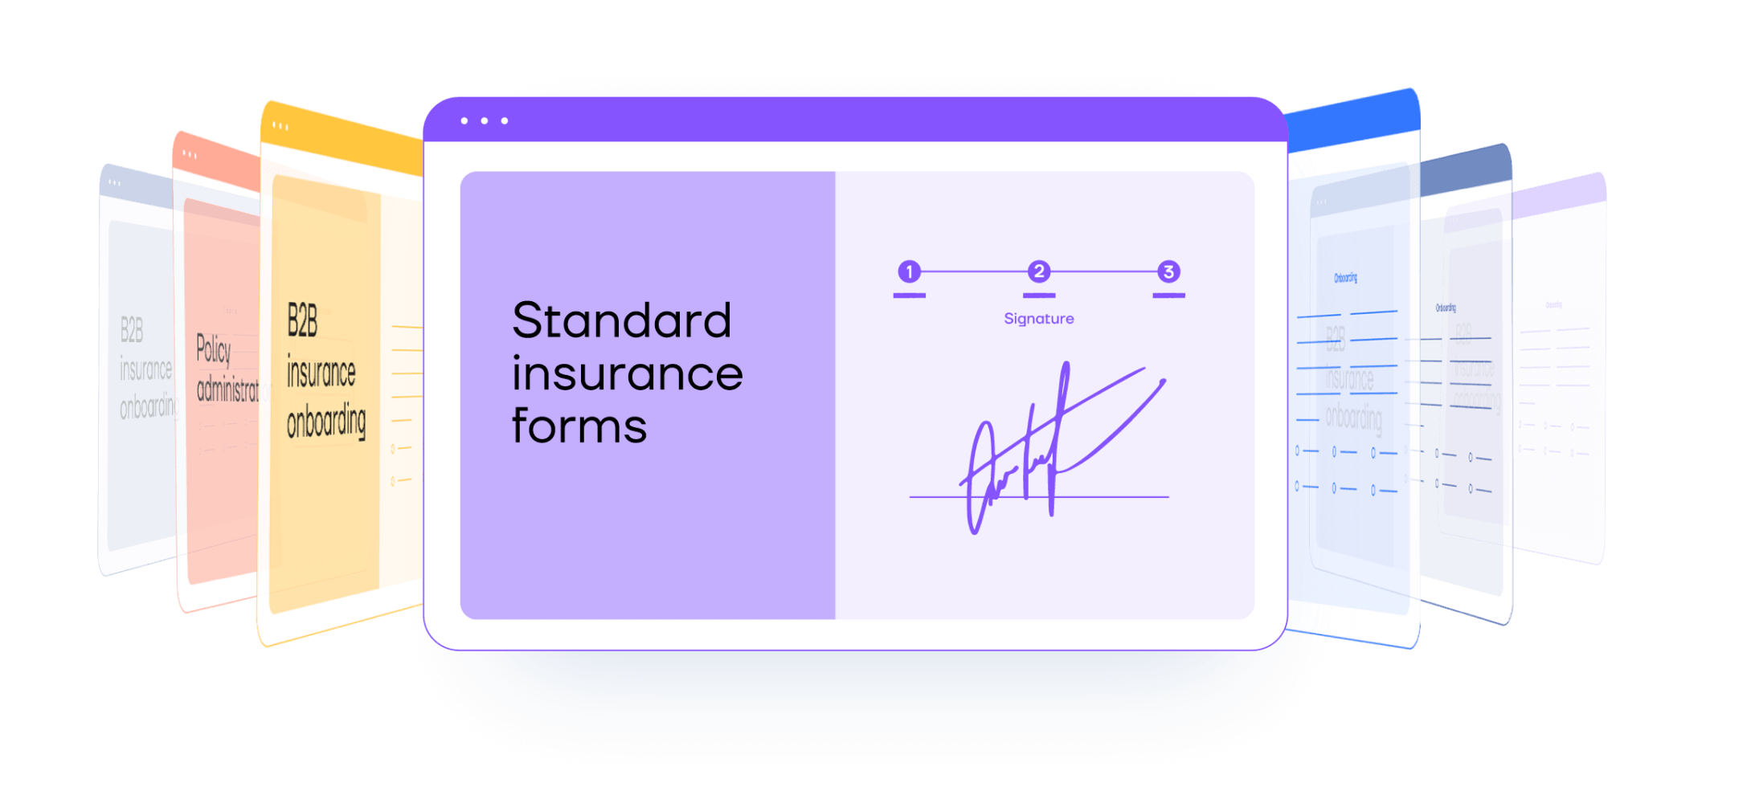
Carte + EasySend
Benefits:
Integration with core systems such as VieFUND
Workflow automation
No-Code
Analytics
Co-Browsing
E-Signature

Slide 13
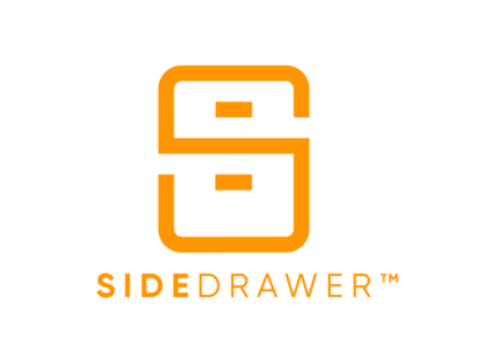
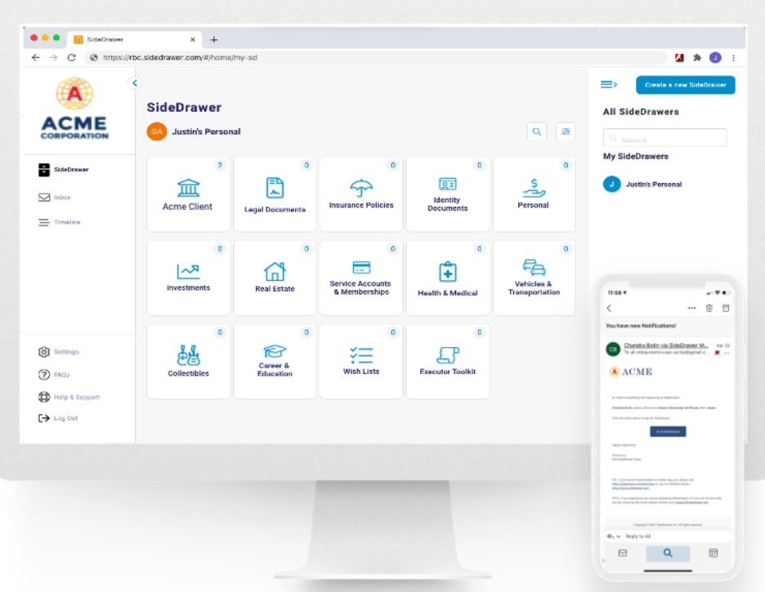
Carte + SideDrawer
A fully branded, document workflow platform to save you time, improve your security and provide your clients an excellent user experience.

Slide 14
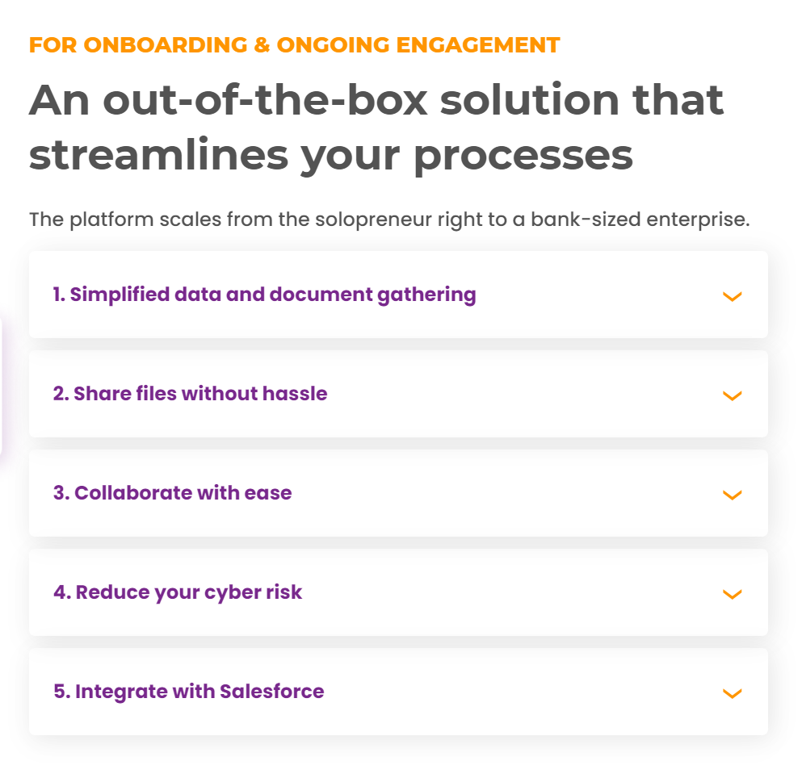
Carte + SideDrawer

Slide 15
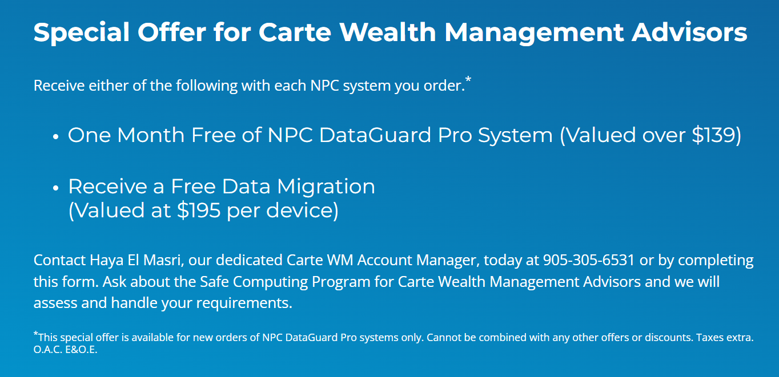
Carte + NPC
Carte has chosen to work with NPC DataGuard to promote a Safe Computing Program for Carte’s advisors featuring NPC’s turn-key secure computing solutions.

Slide 16
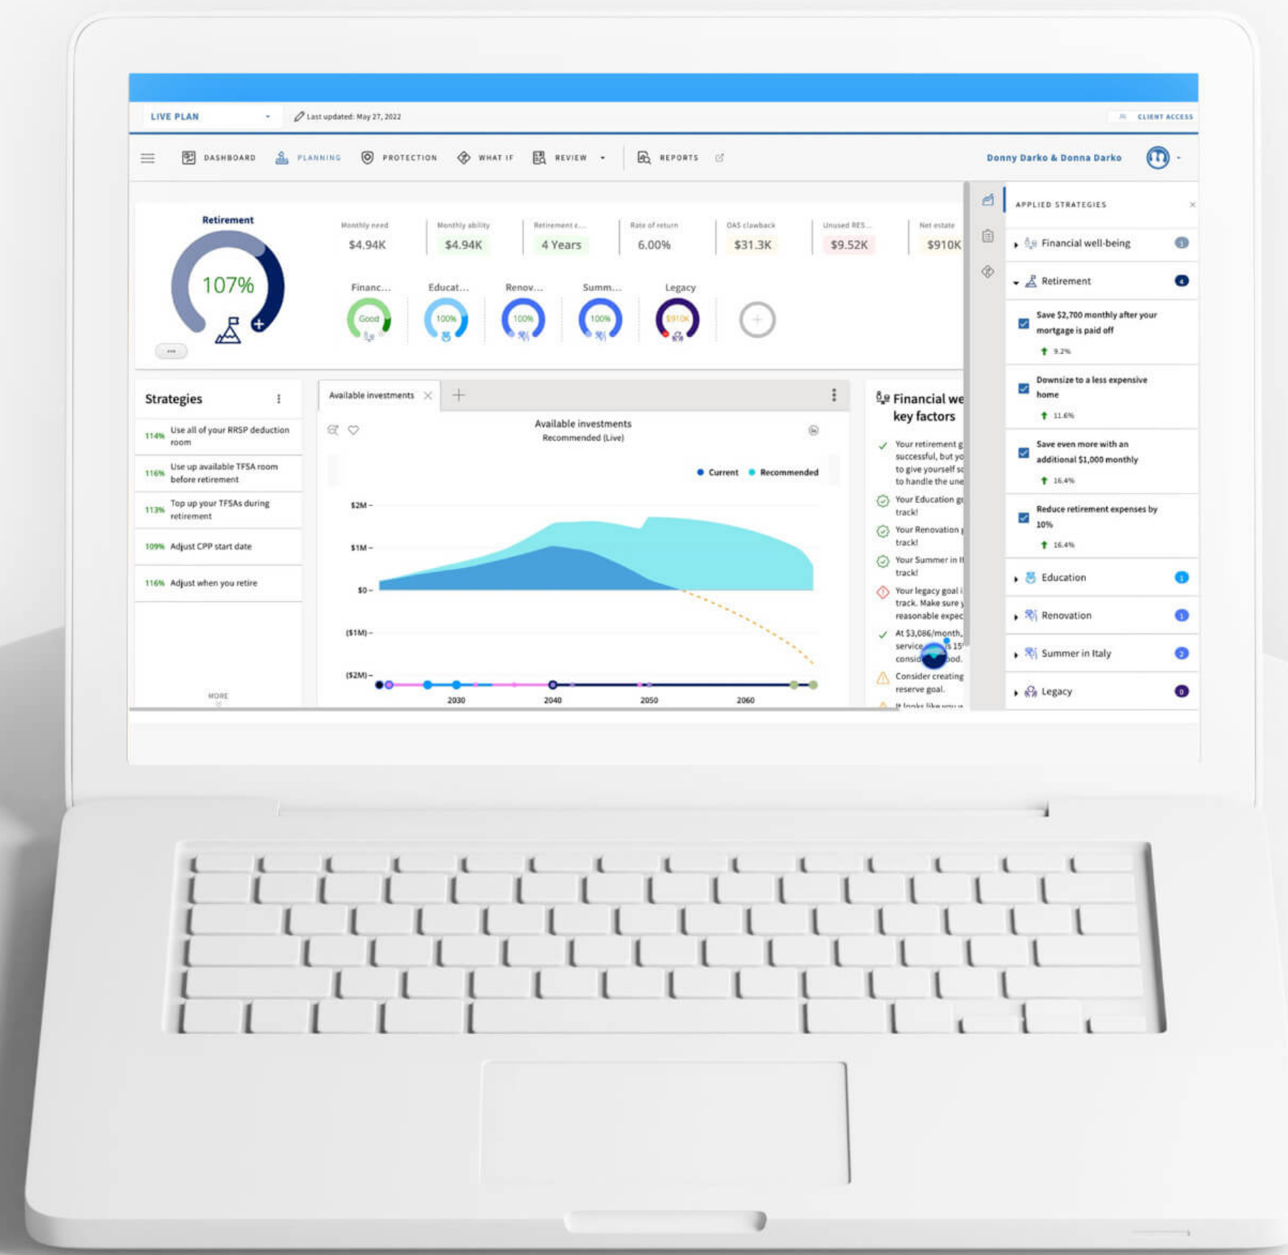
Carte + CONQUEST
Conquest enables personalized financial advice delivery how, when and where customers want it.
Their purpose is to make personalized financial advice accessible to all!

Slide 17
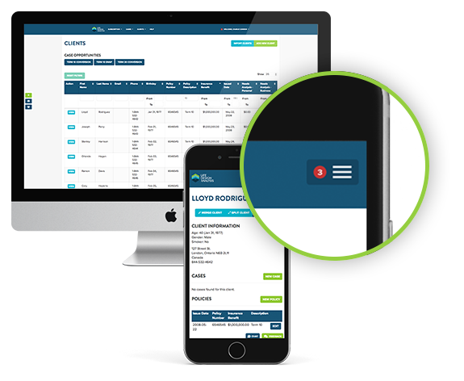
Carte + Life Design Analysis
LDA's insurance management software is created for advisors who want to save time and increase sales.
9/10 people are confused by their insurance options.
The majority of those people are visual learners, who would purchase today if they knew what they were buying.
LDA searches and compares life insurance policies across all major providers, creating an advisor branded visual presentation. Clients understand their options and makes their purchase decision easier.

Slide 18
Explore new ideas,
Embrace new conversations,
Challenge what’s different.
Make this year your BEST year ever!

