Slide 1
Salesforce and the Modern Advisor
Prepared for Carte Connect
October 2022

Slide 2
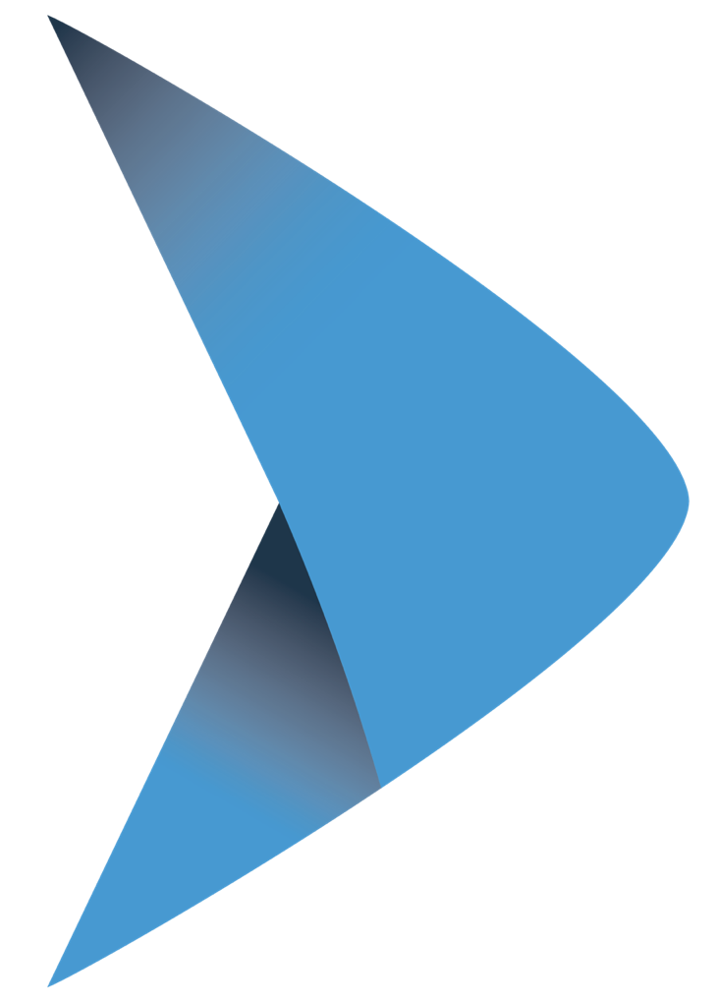
About
Matthew Maingot
9 years Salesforce expertise with focus on designing and implementing solutions for organizations in Financial Services (Wealth, Insurance, Mortgage, FinTech)
Previously Salesforce Canada Financial Services Solutions Engineer
Top 1% Tetris Player

Slide 3
Modernizing the Advisor Experience is Complex
CRM
Client Portals & Mobile
Financial Planning Health & Wellness
Smart- Connected- Mobile First
Compliance
Comprehensive Wealth Management
Portfolio Management
CRM
Financial Planning
Business Intelligence
Digital Marketing
Portfolio Management
Marketing Insights & Tools
Risk Management
Document Management
Old Way- Prospect, Plan & Invest
New Way- Deepen Relationships, Personalize, Scale & Grow
Notes:
Top priority for most wealth firms
So- What Does it Take to Enable the Advisor of Today?
The modern tech has changed a great deal from 20 years ago- today's tech stack needs to fully support the advisor - client engagement model, power productivity and touch every part of an advisors business.
Many firms still challenged with trying to modernize the advisor experience, help them scale their reach, personalized interactions, anticipate client needs and behavior and help advisors save time and operate more efficiently and effectively.
It used to be that the Advisor tech stack was mostly focused on prospects, portfolio management, transactions
Today it is much more complex - consisting of sometimes over 20 applications that need to connect and share data across CRM, Financial Planning, Portfolio Management, Custodial Platforms, BMP and Document Management, Marketing applications and more. Lack of integration, bi directional data share and fragmented UX are some of the biggest complaints- followed by manual process, time consuming -redundant data entry.
-CRM is the engine that unites all activity around the client exp- Prospecting, Lead Management, Client Activity
-Client Onboarding, Document Management & Workflow
-Financial Planning & Wellness
-Portfolio Management Tools
-Risk Management
-Compliance Solutions
-Client Portal & Mobile Access
-Digital Marketing & Thought Leadership
What about the UX?- - the ideal experience should be SIMPLE, INTEGRATED and a unified experience- where data flows easily between all systems and the UX is simple.
To continue to be successful Advisors need to:
#1. Enrich the Client Experience- Interact with Clients When, Where, and How they want- make it inclusive, easy, personal, relevant - and valuable
#2 Be empowered with a robust view of the C360 -Clients want to know that You Know Who they Are, What they Need, have a rich client profile, be able to track client activity, have data driven insights, next best actions and tools that help them become more proactive and less reactive.
#3 Provide Advice In Context of Life Moments and Planning for All Generations- Advisors are trying to juggle engagement and service with UHNW, HNW and Next Gen- it is critical they have the ability to scale their reach to all clients in their business and personalize every engagement so that clients feel "my advisor knows me, my wants, needs, preferences and how to advise me at this point in my life"

Slide 4
Industry Dynamics Impacting Wealth Management
Wealth & asset management firms globally are accelerating investments for transformational change
Rising Customer Expectations
Advisor Experience
Race for Efficiency
Economic Disruption
Regulatory & Compliance
Data is Gold
Deliver value, personalization, and “know what I want” through digital channels
Empower with connected data & platforms to improve productivity
Intelligent automation for work orchestration enabling a scalable service model
Future of work driven by social impacts, climate change, and technology
Increasing complexity, cyber security, and data privacy creates a need to surveil and monitor
Trusted data is where advisors will go. Machine learning/AI will power the advisor more than ever before
MODERNIZATION OF FOUNDATIONS & DIGITAL TRANSFORMATION
Notes:
Industry Trends
Wealth Management firms around the world are on a multi-year to modernization their business, technology, policies, and procedures
They are and have been accelerating investments and timelines for transformational change; especially now given the current economic climate
Firms are pivoting their priorities to rethink the workplace, streamline operating models, and scale for growth
Financial Advisors have shifting job responsibilities from investment management to life planners
6 Main Industry Dynamics That Continue to Impact Wealth Firm Priorities
Responding to Changing Client Expectations
Reimagining the Advisor Experience
Race for Efficiency
Economic Disruption
Regulatory and Compliance Pressures
Data, Data, Data
Underlying all of that is the Imperative for Rapid Digital Transformation & Modernization of Tech Stacks
Today we will focus on the first 3 trends
Leaning into Changing Client Expectations
We all know clients want on demand everything, multi-channel experiences, and to play an active role in their wealth mgt. It has now evolved to you should know what I want! Segment needs are merging amongst UHNW, HNW and Next gen. ALL expect experiences to be simple to use, integrated, operate with speed, and enable them with self service and on demand engagement. Most importantly - DIGITAL!
HNW investors are becoming younger – excelling in careers and earning faster than prior generations. Salaries are higher than ever before! We also see younger generations are also better savers. They want accessible and affordable financial planning options, easy access to crypto (maybe not right now), the flexibility of micro-investing, and they care about social impact investing like ESG, charitable giving options, and their carbon footprint.
All 3 segments expect their financial advisor to know them very well - with constant reach outs with relevant information, serving up personalized experiences like they have with consumer tech. Wealth firms must rise to the challenge, fast, to reinvent client experience, streamline service models, offer new planning, investment options, and value.
2. Re-Imaging the Advisor Experience
This is one of the most important trends right now. Time is a luxury, and Advisors need more of it! Advisors struggle to prioritize their day, identify new prospects all while retaining, enabling, and educating the existing clients.
Wealth Firms are challenged to help them remain relevant and offer new value.
At the same time wealth firms are doubling down to attract the Next Gen Advisor that will help redefine the firm’s brand, accelerate growth and align well to a diverse set of next generation clients. The connected Advisor with Data and Technology first are highly sought after.
Wealth firms must simplify complexity for advisors, streamline onboarding for advisors and clients, help them scale their engagement models, enable with them with data driven experiences, digital capabilities, and help them evolve to go from stock pickers to “quasi life planning coaches.” This is a new motion for many Advisors who will need to become comfortable with not only answering financial questions, but also life decisions.
3. Race for Efficiency
To reimagine any experience and gain efficiency change must be end to end. Any business process a firm focuses on needs to evaluate the current state and desired future state based on understanding the client journey and pain points. Also how digitally mature is the process (front- middle and back office)
Transforming business processes takes time and many firms target 1-5 a year (the most complex - highest ROI) where can they reduce steps, friction, improve workflow, remove paper offer more STP.
The race for efficiency is all about transforming operating models and gaining scale through Automation, Integration, Digitization and leveraging Robotics and Machine Learning to replace mundane human tasks.
4. Other Facts
A Goldman study took a look at where advisors where spending their time. 37% of it was making investment decisions; however a study of advisor value by clients only puts that at 9%. This highlights the importance of prioritizing what clients want.
Tech integration is Advisors #1 pain point
Top 10 Millennials and Gen Z’s Concerns: Savings, Debt, Student Loans, College Tuition, Buying a home, Rent, Retirement, Employment, Car Payment, Investments

Slide 5
Big Shifts in Advisor and Clients Behaviors
Advisors on the Move
Client Views on Investing
Relationships with Advisors
Client Behaviors & Fees
Risk mitigation & diversification is a key objective
My advisor has found new ways to engage with me
I include family members more in wealth decisions
51% of advisors think of leaving their current firm in search of better technology
50%
46%
44%
More concerned about regulatory & tax changes
37%
Relied on my advisor for ongoing support
41%
I am more willing to pay fees for advice
49%
77% of advisors report losing business due to inadequate technology
40%
Digital access is a higher ongoing priority
Moved from passive to active management
36%
Became more reliant on guidance from provider
42%
I spend more time with my finances & investments
38%
More interested in holistic financial planning
More at ease working with digital tools
42%
30%
62% of clients are likely or very likely to move with their advisor
Poor personal service hurt my advisor relationship
33%
I prioritize succession planning
38%
Finding new sources of returns is a larger priority
24%
32%
I am reevaluating my wealth management fees
ESI ThoughtLab’s Wealth and Asset Management 4.0 Study 2021
Notes:
You can show this slide if you want, it's a lot, or grab the most meaningful stats that will resonate with the client and talk to it on the previous slides

Slide 6
What does great look like

Slide 7
Salesforce for
High Performance Wealth
Realizing Efficiencies For Your Digital Transformation
Continuously Learn More About Me
Share New Insights With Me
Find Me - Don’t Make Me Find You
Integrated Platform
Don’t Keep Asking Me For The Same Info
Meet Me When & Where I Want
Improve the Client Experiences
Interact with Clients When, Where, and How they want
Market Leading Growth
Retain existing clients intergenerational wealth transfer while attraction the next gen of advisors
Optimize Technology to Support the Client Experience
The FSC Platform will support innovation and enable continuous change paced with rapid technology evolution in a digital world
Share My Info With Others
I Choose
Make It Easy For Me To Do Business With You
Work With My Other Trusted Advisors and Your Back Office
Seamlessly Open Accounts & Move Assets
Wealth Transformation
Create A Customized Plan & Execute Based On My Goals
Help Me Learn What I Need To Know
Provide World Class Customer Service
Notes:
Wealth Family in the middle
Market Leaders are looking to us to enable their Customer 360,
The core of our vision has been that every business needs a Customer 360, powering insights and experiences that span the entire customer lifecycle across all touchpoints, digital and physical.
SF applications that enable all the key elements of the Customer 360 — FSC, sales, service, marketing, analytics, integration — are all leaders in their respective markets, and the recent Slack acquisition takes our offerings to the next level with Digital HQ, making it easy for employees, partners, and customers to collaborate to help customers be successful.
The heart of the Customer 360 vision all leverage core cross-cloud, cross-enterprise functionality that is required to truly provide the holistic view of the customer and power these next generation compelling, personalized experiences at every customer touchpoint.
This platform leverages the trust and scale of Hyperforce architecture to allow businesses to easily create a single source of truth, and then leverages AI and AI-infused workflows to deliver those next-generation experiences.
What wealth family needs and expectations for their Advisors
Icons represent the SF ecosystem and all the capabilities that go beyond core CRM to power experiences and personalize them
Salesforce empowers the advisor by creating a central hub of information where advisors have, at their fingertips, everything they need to prepare for their day. With Salesforce at the heart of the C360 an advisor can easily access what they need to to prep for meetings with their clients, send those birthday cards to client's with upcoming birthdays and see leads or referrals they might want to start working on right away. The modern advisor experience is one where an advisor can easily, without leaving Salesforce review a client's goals and gather new investment information to help their clients achieve their goals, provide world class service and interface with their back office operations whether in the same office or distributed.
The connected customer wants:
- an advisor to be able to gather investment information based on their goals
- for an advisor to continuously learn about me and share new insights
- to not keep asking me for the same information.. the advisor should have everything they need

Slide 8
What are we focusing on at Carte?
Taking the standard Salesforce product and creating a custom version tailored to Carte Advisors
Integrated with VieFund, SideDrawer, EasySend and Outlook to serve as the center of your practice
Developing an Advisor onboarding process to give you a smooth transition to the Salesforce platform

Slide 9
Demo

