Slide 1


Collaborative Digital Vault

Slide 2
Disclaimer
Confidentiality
This document is strictly confidential and contains information intended only for the direct recipient from SideDrawer Inc. With receipt of this document, the recipient acknowledges and agrees that: i) the recipient will not copy, fax, divulge or distribute this document in whole or in part without written consent from SideDrawer Inc. ii) if the recipient does not wish to pursue this matter this document was intended for it will be returned promptly to SideDrawer Inc.
Safe Harbor Statement
Any unreleased features or services referenced in this or other presentations may not be currently available and may not be delivered on time or at all. Customers who purchase our services should make the purchase decisions based upon features that are currently available. SideDrawer Inc. assumes no obligation and does not intend to update these forward-looking statements.

Slide 3
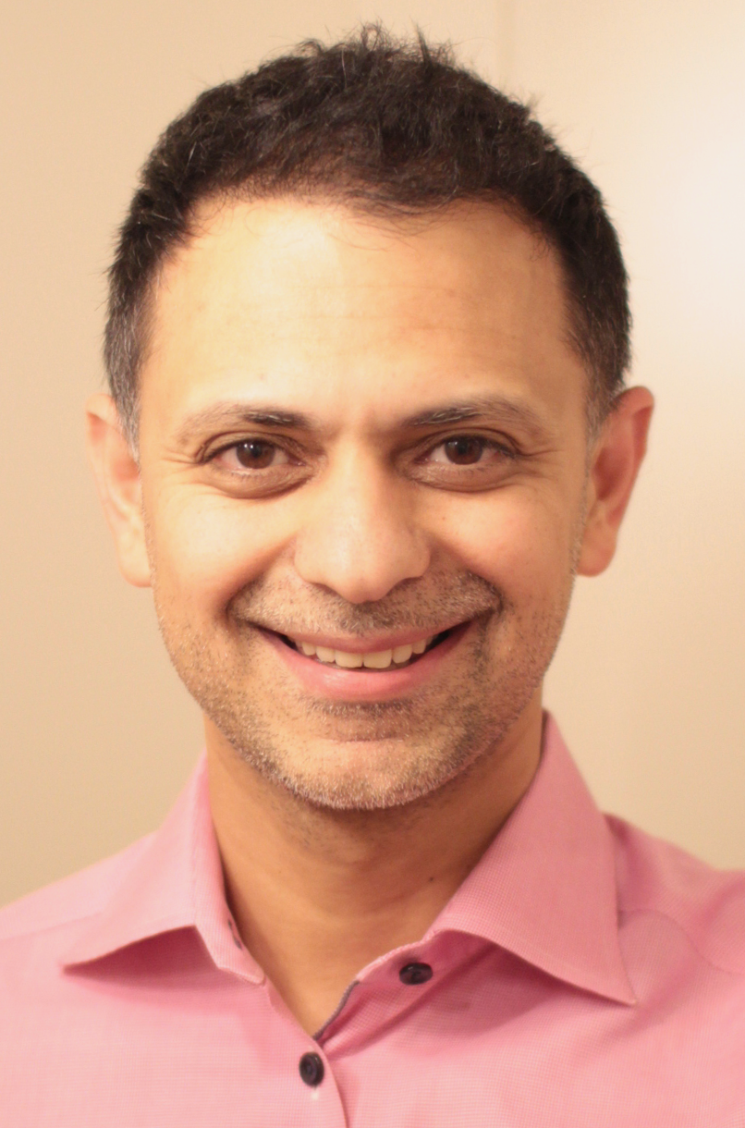
Introduction
Co-Founder of SideDrawer
B.Comm, Trinity College, University of Toronto
CA, CPA and CFA designations
Former institutional equity sales at CIBC and UBS
Idea originated from personal need
Work with an impressive team experienced in security, payments, and operating in highly regulated sectors

Slide 4

Foundational question
If I died tomorrow, would my spouse
know where all our stuff is?

Slide 5



We are digital hoarders
Dropbox has 4.5GB across 4,000+ files
Google Drive has 105GB across 9,000+ files
Gmail has 50,000+ emails
… growing every year and getting more complicated at every stage (marriage, children, etc)

Slide 6


Advisor is critical to every family
Client
Advisor

Slide 7





Despite multiple professionals
Lawyer
Bookkeeper
Accountant
Client
Advisor
Banker
Insurance Specialist
Executor
Mortgage Broker

Slide 8













But collaboration is messy
Lawyer
Bookkeeper
Accountant
Client
Advisor
Banker
Insurance Specialist
Executor
Mortgage Broker

Slide 9

Simplified, secure collaboration
Lawyer
Bookkeeper
Accountant
Client
Advisor
Banker
Insurance Specialist
Executor
Mortgage Broker

Slide 10




What is SideDrawer?
2 way data & file exchange
Productivity workflows
Security is top priority
Intuitive user experience

Slide 11
3 consistent problems we solve
I want to save time exchanging information with my clients
65%
Reduction in doc admin time (approx. 250 hours)
I want to streamline the data and document collection process
3-5x
Faster client response due to intuitive experience
I want to reduce the cyber risk for my practice and liability to my clients
100%
Reduction in sensitive email exchanges

Slide 12
The “admin time” problem
Crafting intro email with multiple attachments for prospects, new client onboarding
Responding to client requests for previously sent/mailed information
Crafting emails to clients’ professionals or families on planning related items
Crafting email with itemized requests
Comparing received items against request checklist
Crafting email with attachments ahead of client review
250 hours
“We have great success with our clients. We can respond faster and be
more proactive. We do not need to dive into emails and attachments,
and it improves the customer experience. On average, I can say that
SideDrawer easily saves us one hour of work per day.”
Andrew Smart, New Outlook Wealth
Per year saved

Slide 13
The “collection” problem
Sending check list of items required for a holistic estate or financial plan
A complete list could include as many as 75-100 documents that require review
Scheduling an interview for qualitative datapoints (e.g. beneficiary names) or requiring forms to be completed
Optimizing ability to collect as many datapoints as possible to create a comprehensive plan
Track responses to emails/checklists to ensure items are received
Politely crafting response to client communicating outstanding/incomplete items
Poor client experience being told what’s outstanding
3-5x
“Planning is the foundation, but we also have a variety of other engagements. Given each engagement has different needs, SideDrawer allowed us to template our data gathering and client communication by type of engagement, making us quite streamlined and efficient.“
Christopher Dewdney, Dewdney&Co
Faster client response due to intuitive experience

Slide 14
The “security” problem
“Cybersecurity is one of the things that keeps me up at night” is repeated by almost 100% of advisors
Ipsos poll on behalf of RBC stated that 76% of respondents in age groups 35-54 and 55+ are concerned about their social media or email being hacked.
We know that mailboxes are hacked on a regular basis - exposing all client data within Inbox, Sent Items, Deleted Items, Draft Items
For the advisor, there is exposure to cyber, E&O, D&O, reputation and liability
100%
“Receiving the client’s sensitive information was a risk factor, and I chose to reduce that liability by partnering with SideDrawer.”
Rolf Issler, Issler Group
Reduction to sensitive email exchanges

Slide 15




Current solutions are inadequate
Secure / Protected Email
One-way, outbound secure only; client’s inbound remains exposed
Exceptionally poor user experience
83% of IT professionals acknowledge the experience is not convenient for clients¹
Does not address data privacy regulation
75% of companies infected with ransomware were running up-to-date endpoint protection²
Traditional File Sharing
Limited notifications to engage clients, team members or collaborators
No secure form or data collection capability
Still requires file sharing links which can expose underlying data
No ability to leverage enterprises’ existing low-cost storage and infrastructure
Difficult to maintain compliance with increasing data privacy regulation
Client Portals
Limited ability to collect meta (informational) data beyond the document
No/limited collaboration features
Poor mobile app experience
Generic portals have questionable security measures to meet today’s increasingly advanced threats
Custom portals do not offer secure document handling and multi-user capability
Limited ability to meet increasing data privacy regulation
¹ Altn
² Sophos

Slide 16
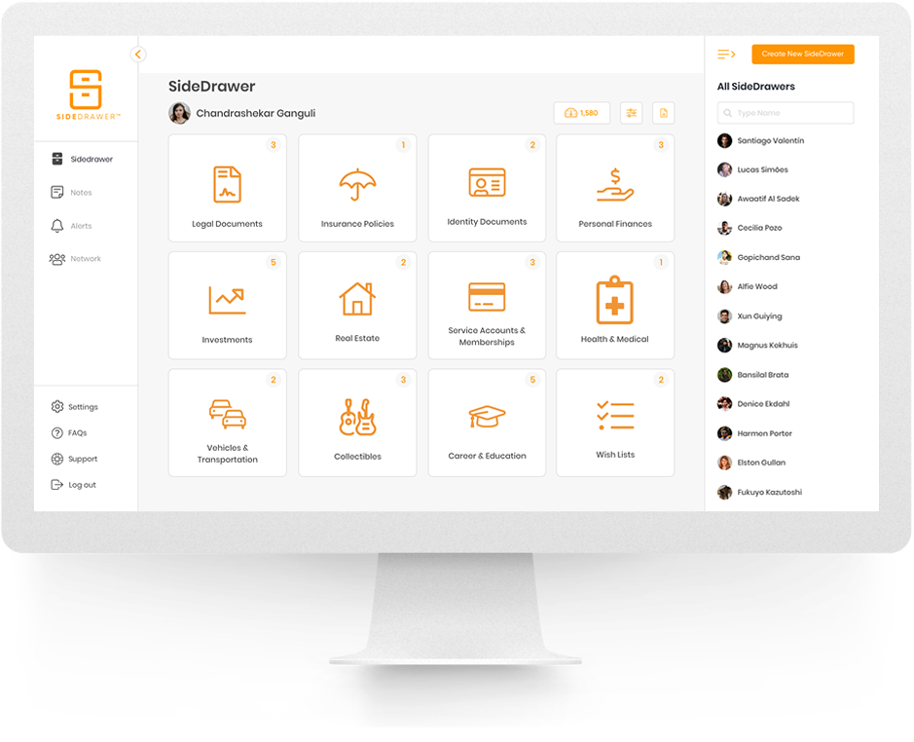

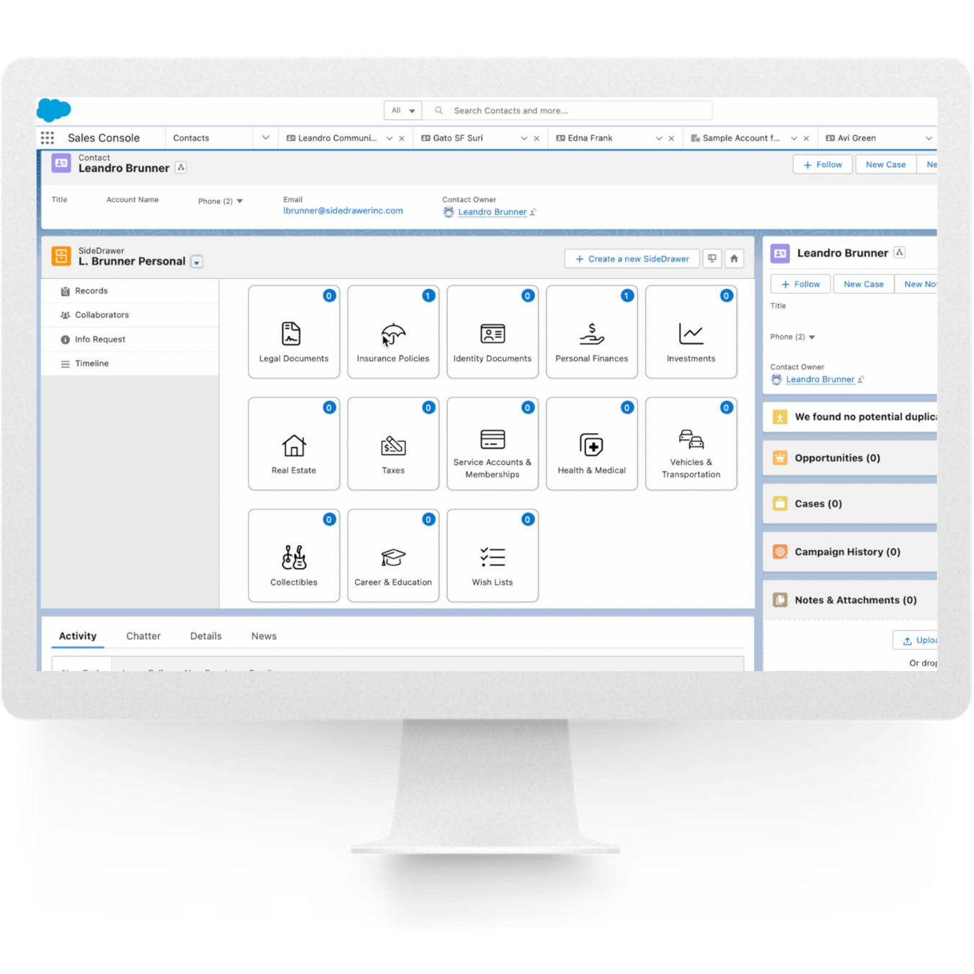
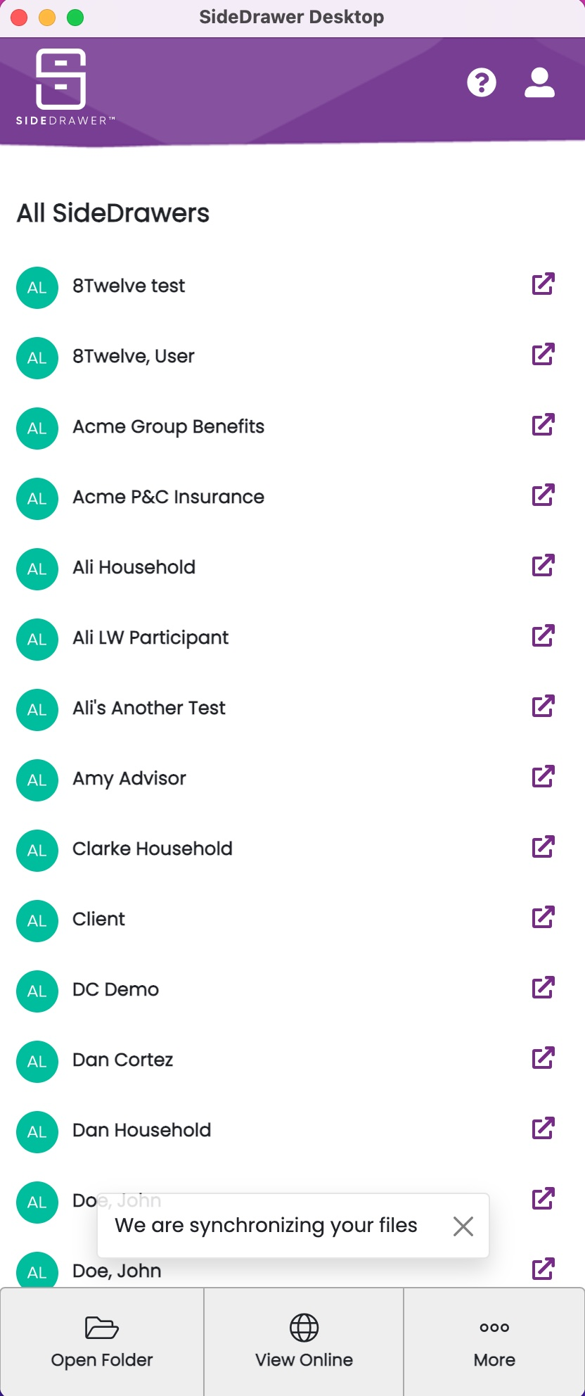
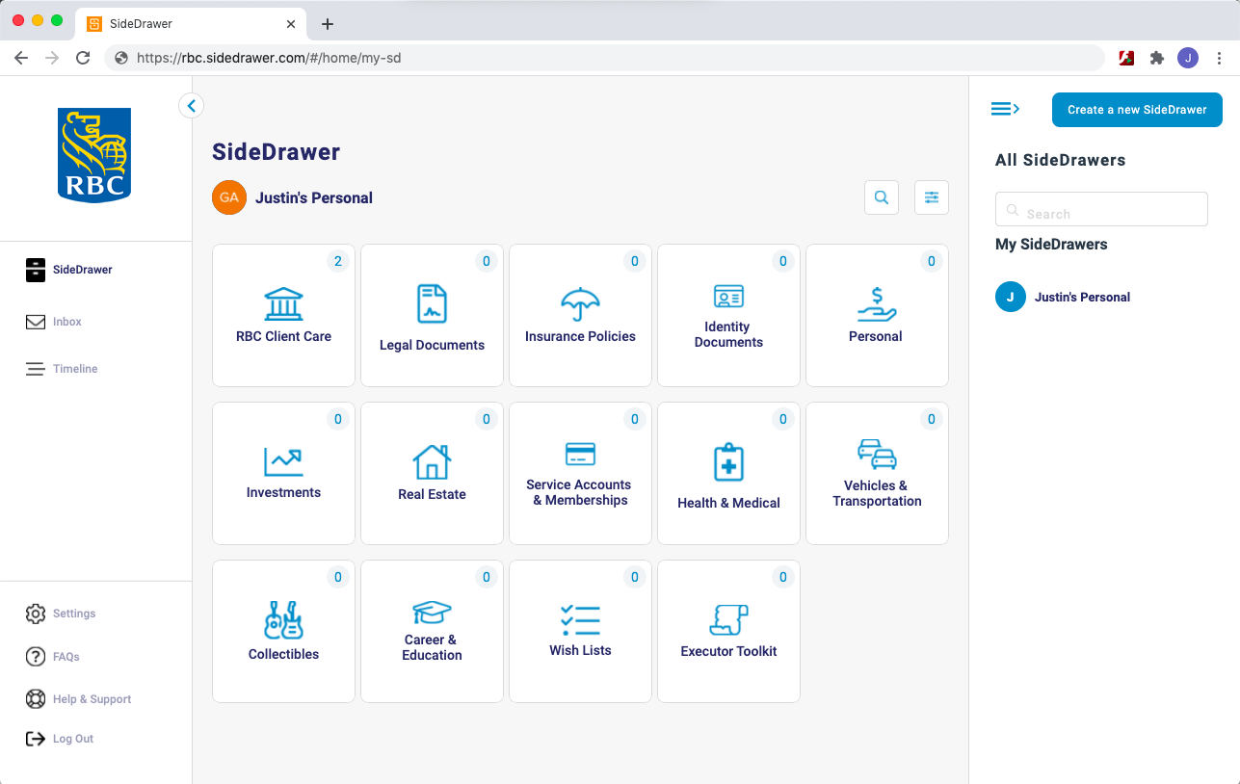
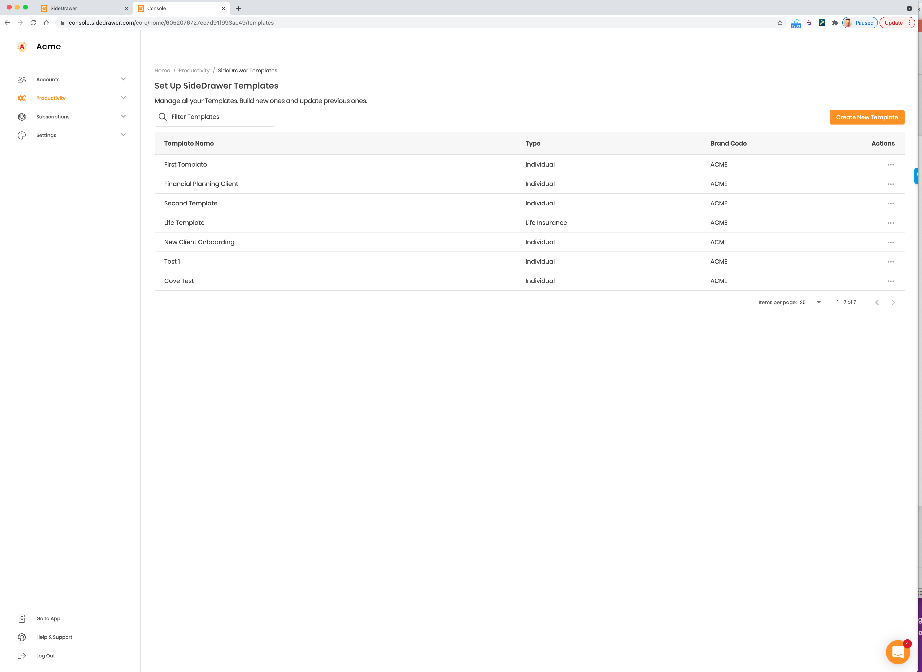

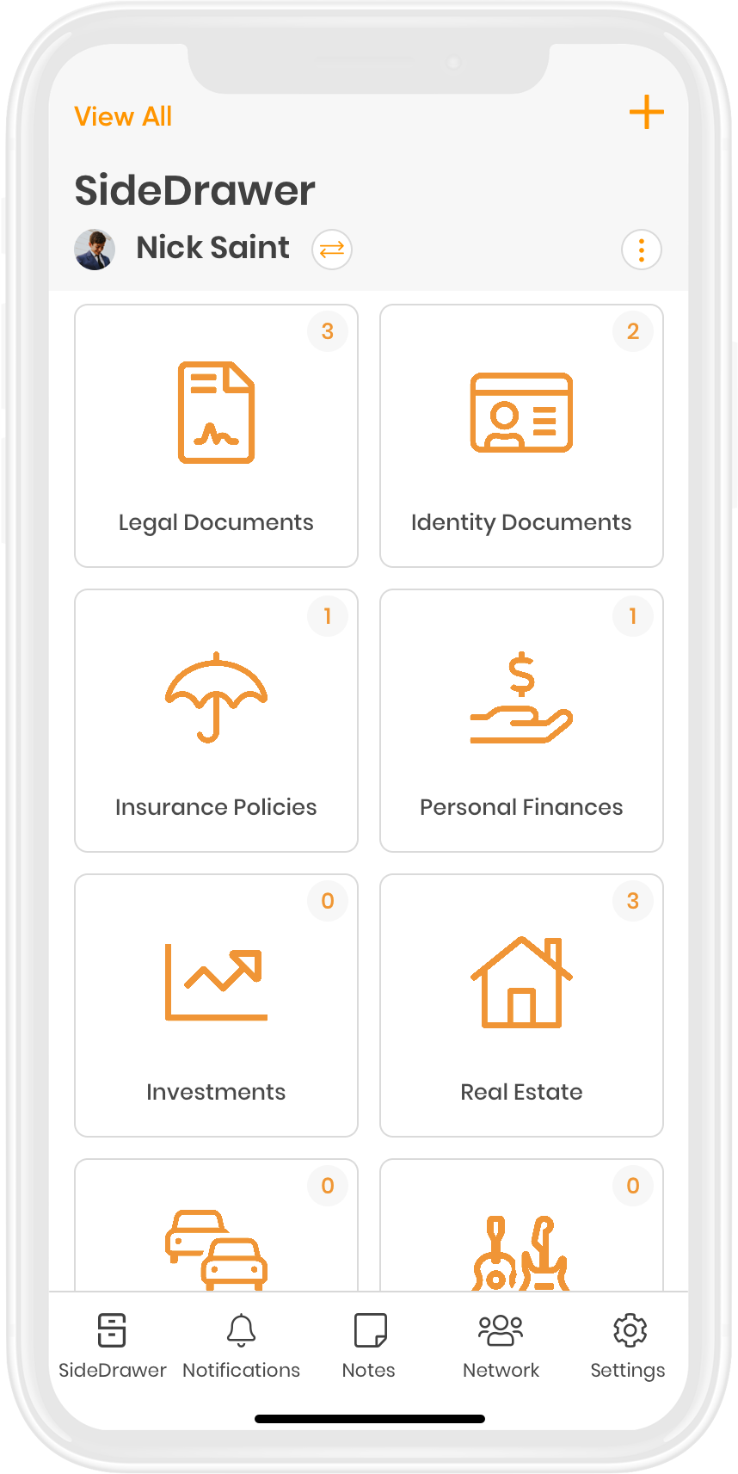
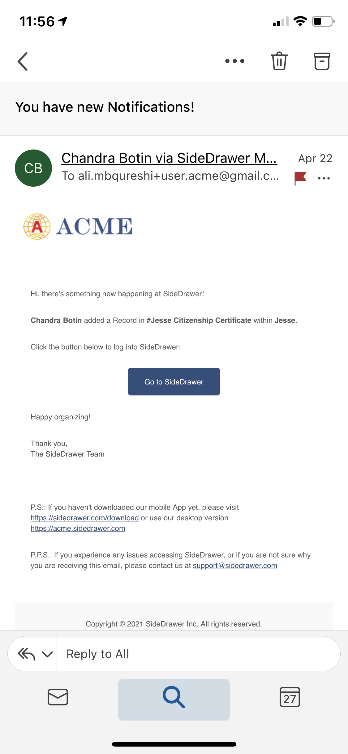

Advisor & Client experience
Advisor Branded Web and Mobile Apps
Admin Console
SideDrawer Salesforce LWC
SideDrawer Desktop
Acme Client
Used by clients, advisors and admins
Secure productivity workflows
Easy collaboration
Intuitive interface with minimal learning curve
iOS & Android mobile apps
Used by advisors and admins only
Create data and document gathering workflows
Leverage file distribution workflows
Used by advisors and admins only
Use SideDrawer credentials
Leverage common functionality within Salesforce widget
Click here for more details
Used by advisors and admins only
Local file desktop sync capability of cloud files
Similar experience as other cloud based storage tools
Click here for more details

Slide 17

Integrated experience
Documents
Single login as SSO maintains client login credentials
Eliminate any 3rd party file sharing need
Reduce data sprawl
Your
Client
Portal
Acme Client

Slide 18


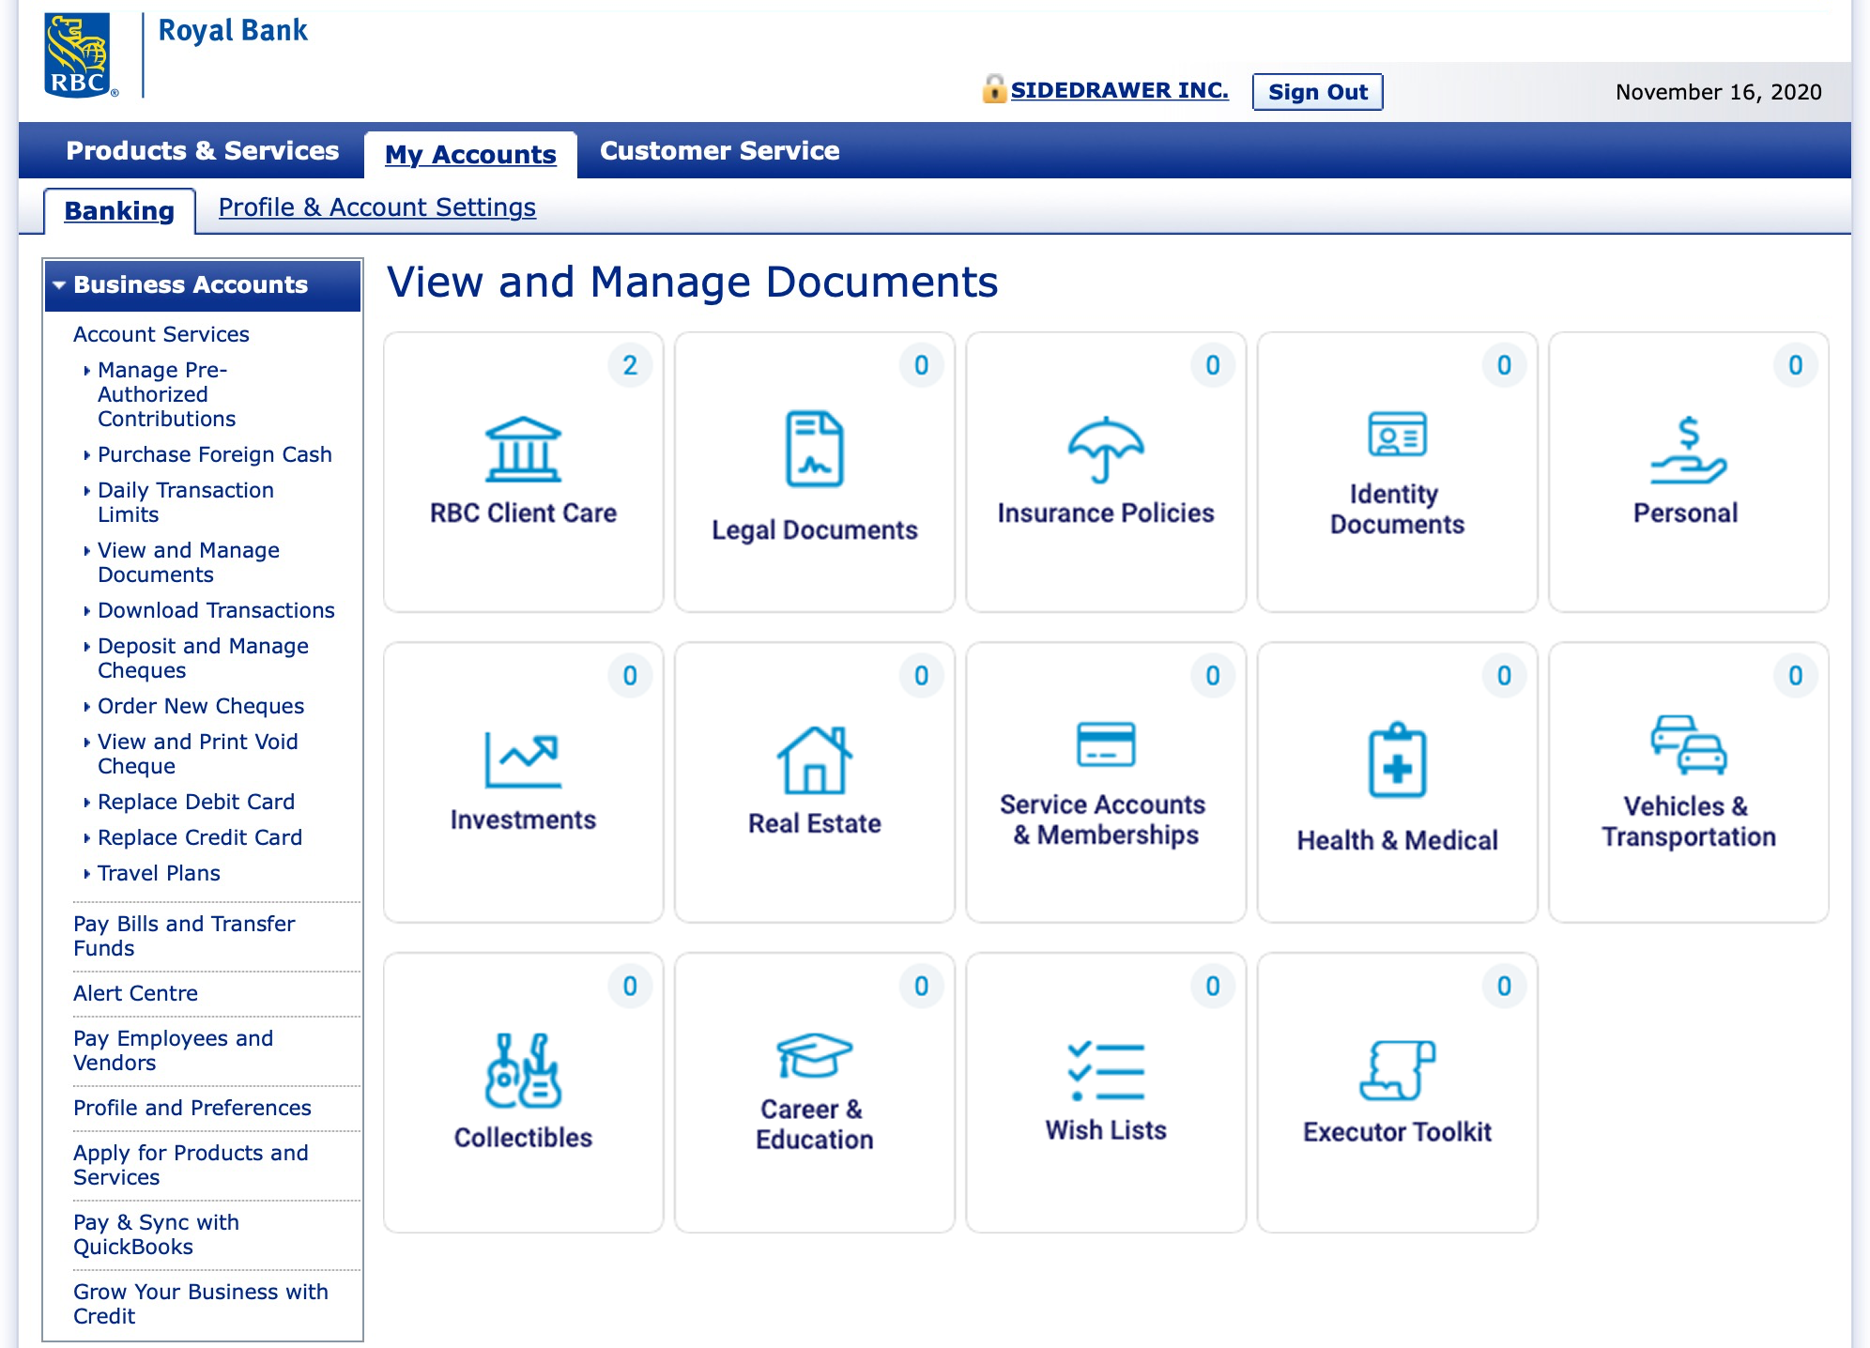
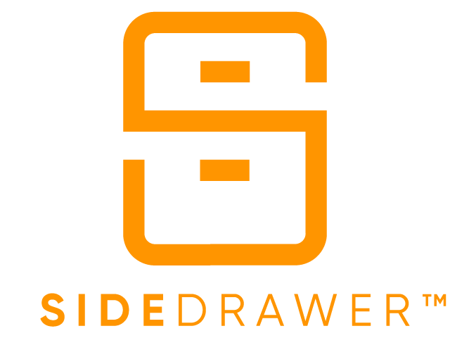





Complete, flexible enterprise capability
Store client data on your own infrastructure
Incorporate SSO, workflows, or consume webhooks to power existing processes
Provide Compliance or Management role-based access through a Console
Acme Client
Bi-directional data and document flow
APIs
Manage internal staff access securely through Salesforce widget
Allow internal staff access to local cloud storage (OneDrive, Sharepoint, Dropbox, Box.com, etc)
SideDrawer integrated into your client-facing web or mobile application, Salesforce Communities, or SSO to a new click-out

Slide 19
Appendix

Slide 20
SideDrawer vs. other platforms
 | SideDrawer | Other Vaults | Box.com
API-first design for enhanced integration capability | Yes - 100% | None | Has Public APIs
User focused intuitive design | Yes | Limited | Yes
User and team based intuitive permission settings | Yes | Some | Some
File and information collection workflows | Yes | Limited | Some
No direct access to any files or data which remains an unsecured method | Yes | Limited | Some
Native Salesforce LWC application | Yes | None | Some
Native OneDrive and Sharepoint integration | Yes | None | None
Enhanced branding capability (login, in-app logo, color scheme, fonts, advisor photo, advisor contact info) | Yes | Limited | Limited
Multi-source statement and document ingestion | Yes | Limited | Limited
Dedicated regional PII storage capability by user | Yes | Some | None
Zapier application for workflow integration into thousands of apps | Yes (Q3’22) | None | Yes

Slide 21
Use cases for Wealth
Offer a secure vault to facilitate collaboration, retention and access controls
Client prospecting questionnaires (determining fit, initial screening)
Client discovery (further information gathering)
Ongoing data and document collection, confirmation (KYC, etc.) through custom or automated forms
Delivering completed work product (e.g. Financial Plans) for future access and review
Delivering monthly or quarterly produced statements
Repository for estate related documents (e.g. Will, POA, etc) that improves client stickiness
Improving practice efficiency by reducing document related admin time by up to ~65%
Reducing email traffic on sensitive data and documents by over 40%
Collaborating with client’s accountant, lawyer, estate, beneficiary, family and executor on sensitive documents
Providing value-add tool for client’s personal and family use beyond traditional file sharing

Slide 22
Benefits for Compliance
Streamlined, efficient document management for compliance
Ensuring consistent and standardized approach for sharing sensitive client data
Precise tracking monitors activity and behaviours for client dispute resolution
Repository of final documents from onboarding system for verification, audits or updates
Provide consistent document organization to expedite internal reviews, audits or regulatory requirements
Provide document source validation for future audits, regulatory requirements or dispute resolution
Leveraging collection of additional data and documents outside of core platform
Leverage reminder functionality to automate notifications for updating any agreements, initiating new forms etc

Slide 23
Benefits for IT & Infrastructure
Document management designed for today’s cybersecurity environment
Ensuring client privacy, security and data protection in increasingly challenging cybersecurity environment
45%+ reduction in email traffic volume substantially reduces risk of cyber breaches and misdirected email
100% elimination of sensitive data and documents over unsecure email channels
User-managed access controls to limit/grant access to other internal users, freeing up precious IT resources
Precise file open/view tracking limits exposure notification to specific individuals vs entire mailbox contacts
Precise file open/view tracking for regulatory fine avoidance in wealth management, investment banking, capital markets and corporate banking (e.g. public side access for private side transactions)
APIs and SDKs provide for easy integration with existing client portals
Improve efficiency on data storage consumption by leveraging enterprise’s own AWS, Azure or VPC storage

Slide 24

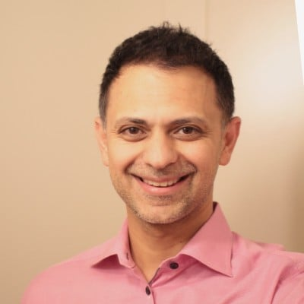
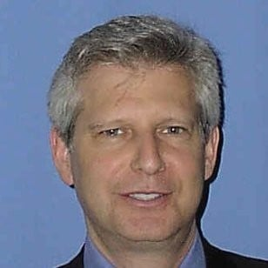
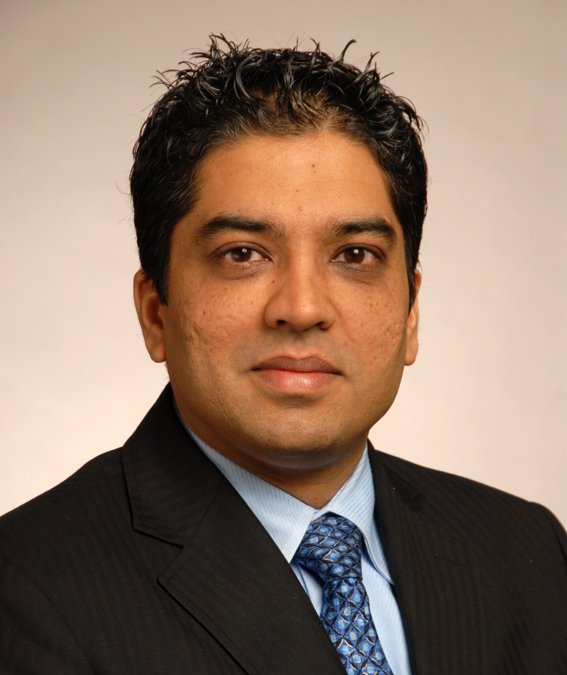
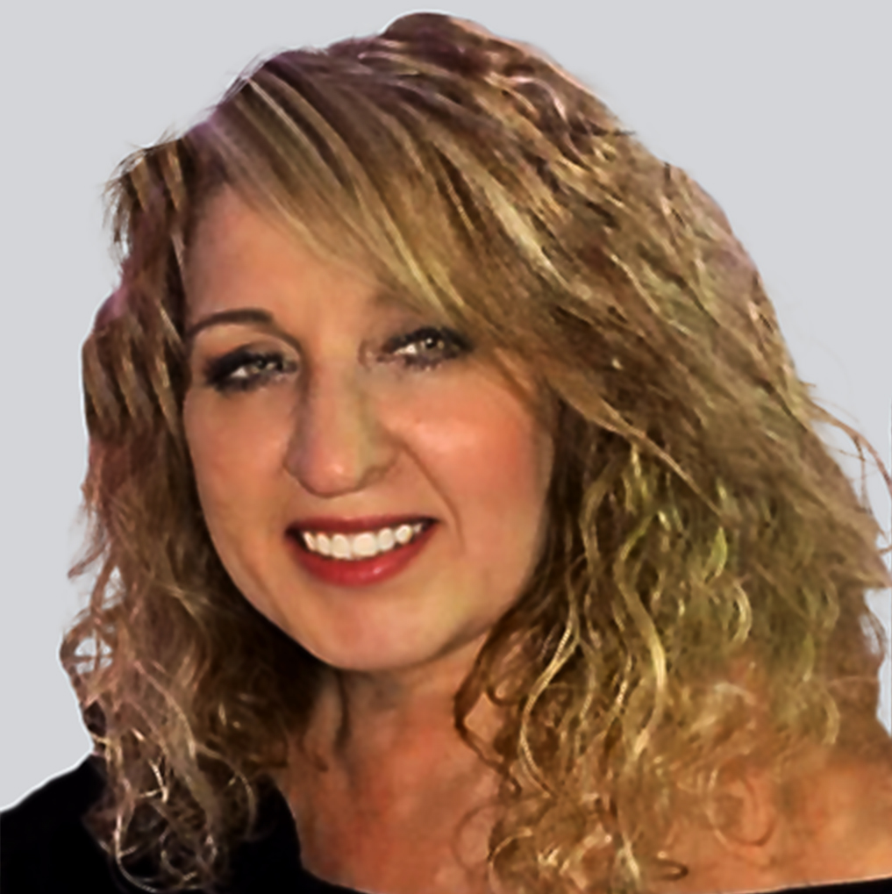

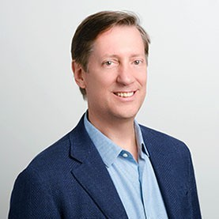
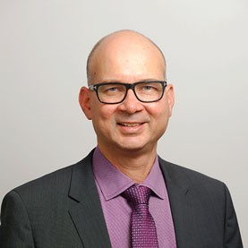
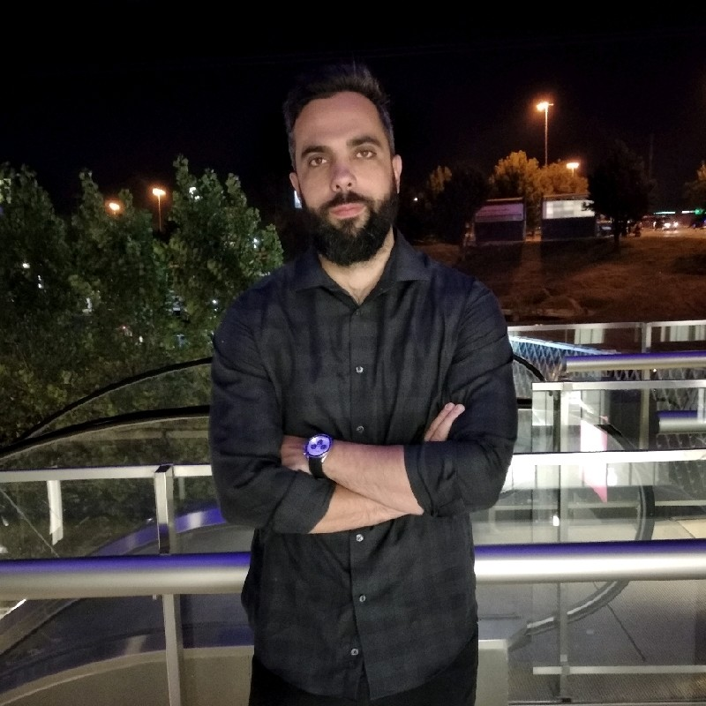
SideDrawer team
Combination of skills across fintech, wealth management, compliance, law and capital markets.
J. Gaston Siri
Co-Founder, CEO/CTO
Former Flexiti CTO, developed credit card processor technology (C$300m book), acquired by NYSE-listed CURO.
Entrepreneur started previous successful businesses.
Ali Qureshi, CA, CPA, CFA
Co-Founder, CRO/CFO
18 years capital markets, research and experience at Canadian and global investment banks.
Former Executive Director & Deputy Head, International Equities.
Marc Milgrom
Chief Strategist
Former CEO of global technology company, prior exit.
Former Partner, PwC, Tax.
Nitin Bedi, MBA, CISA, CISSP, CRISC, CIPT
CISO
Executive with 25+ years global consulting expertise on cyber security, IT audit, risk management and IT governance.
Extensive experience in legal and contractual requirements, and information security frameworks and standards
Irena Storic
VP Operations
Experienced operations, customer service, vendor relations and credit card responsibility.
Prior experience at Flexiti, CIBC, Wells Fargo.
Robert Clarke
VP Sales
Experienced enterprise sale at startups and larger organizations.
Grew Flexiti’s merchant financing from zero to over $1.5 billion prior to sale to CURO (NYSE listed).
Mark Notten & Phil Dias
Enterprise Sales Consultants
Founders of Tier1 Financial Solutions, customized Salesforce CRM platform for global investment banks and capital markets.
Tier1 is an investee company of Salesforce Ventures and MassMutual.
Emiliano Draperi
Chief Architect
Former Chief Software Architect at Flexiti, Canada’s largest private label credit card provider.
Acquired by NYSE-listed CURO.

Slide 25
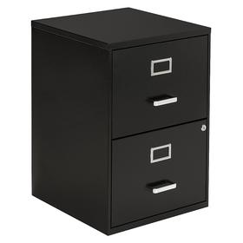

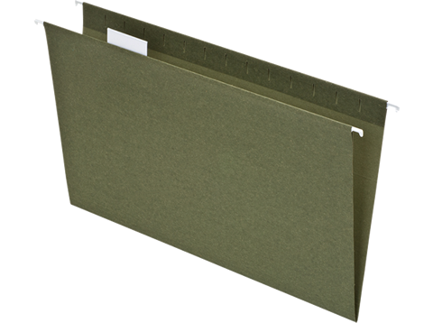
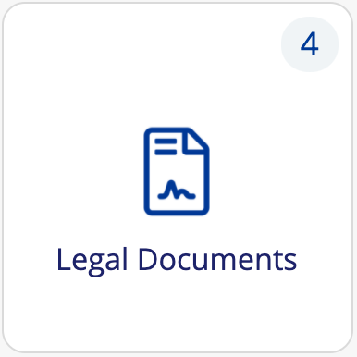

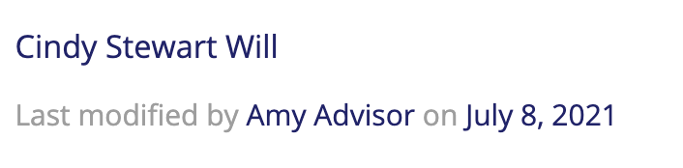
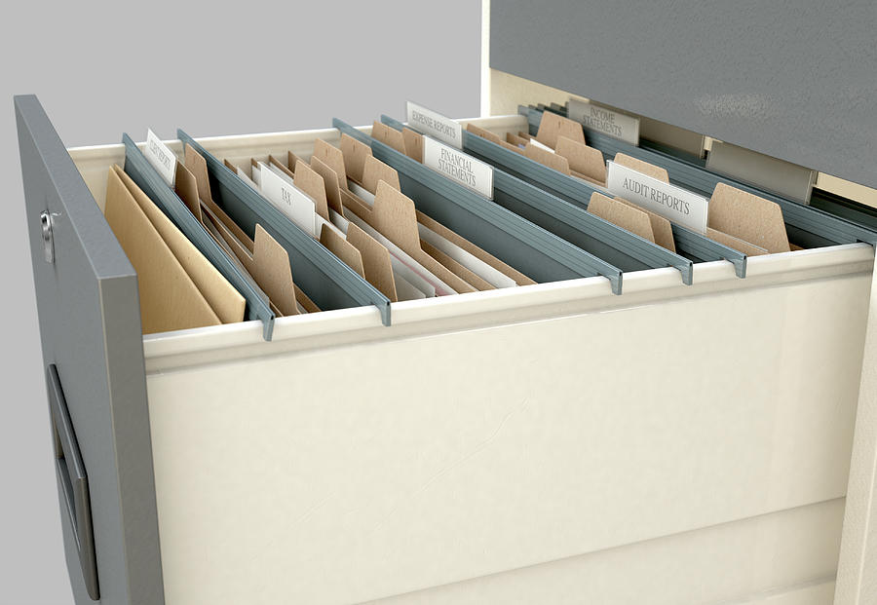





SideDrawer is logical and familiar
Filing Cabinet
SideDrawer Platform (view)
SideDrawer Description
Conventional File Structure
Drawer
SideDrawer
Folder
Green hanger
Tile
Subfolder
Manilla folder
Record
Subfolder
Files
Sticky notes
Scribbles
Files, Structured & Unstructured Data, Tags, Reminders
Files only

Slide 26






Productivity powerhouse
Consolidate processes and workflows within SideDrawer for a secure, improved user experience.
Secure Fillable PDFs
Secure Digital Forms
Organized Document Collection
Offer fillable PDFs within a completely secure environment, with no risk of sensitive client data exposure.
~40% reduction in client click-throughs to complete a PDF vs traditional email attachment.
Create customized forms (personal info, prior to reviews) dynamically within fully secure environment, using front-end or APIs
Deliver to 1 or 1,000+ clients instantly
Monitor completion progress, with auto-completion reminders (reminders coming soon)
Create document requests (onboarding, KYC, new product sales, identity, transfer requests) Deliver to 1 or 1,000+ clients instantly
Monitor progress, with completion reminders to expedite collection by days or weeks
Secure Digital Signature
Blast Document Delivery & ETL
Web, iOS and Android apps
Built-in digital signature offers more secure signature collection given unique user authentication
Deliver 1 or more generic document to multiple SideDrawers (eg Newsletters)
Deliver client statements from multiple sources to individual client SideDrawers (eg account statements)
Completely branded web experience at yourname.sidedrawer.com, and mobile apps with your logo
Excellent user experience designed with the user in mind

Slide 27




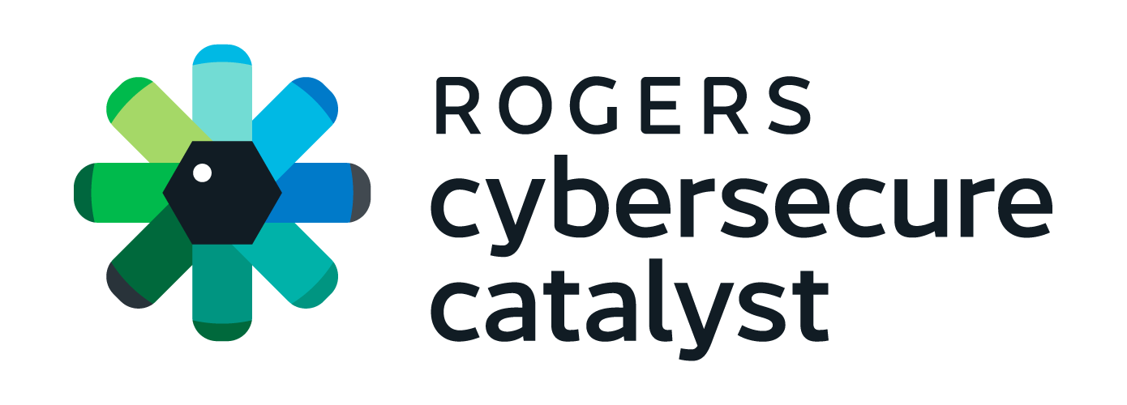

Industry partners and recognition
SideDrawer recommended as document collaboration solution on DigiCat 2.0 technology catalog
SideDrawer is a strategic partner of CEAN the professional association representing CEAs
Member organization of 30+ benefits, wealth and insurance firms
SideDrawer is a strategic partner
Member of Cybersecure Catalyst, Canada’s first national cybersecurity accelerator.
NPC is a secure mobile computing software and hardware solution provider
Cross-referral sales partner
Excellence Awardee (Finalist) for WealthTech Provider of the Year, 2022

Slide 28
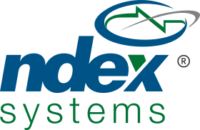







Technology integrations
1
1
1
2
Q422
Q123

Slide 29




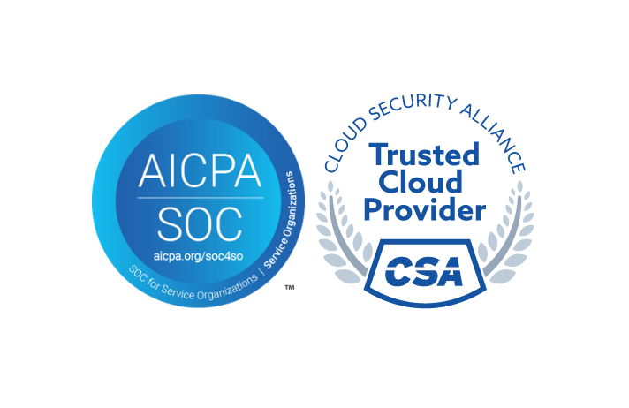


Compliance & Security
All data is stored in the user’s location of residency from the time of account creation and is entirely managed by the API. This ensures compliance with Canadian PIPEDA, US HIPAA and EU GDPR requirements.
All exchange of data is encrypted using bank-grade AES 256-bit encryption, and TLS 1.2 and 1.3 protocols while in transit and at rest, including uploaded files.
SideDrawer is SOC2 Type II certified, along with STAR Level I certification under the Cloud Security Alliance.
SideDrawer conducts external penetration, has monthly internal cybersecurity reports, along with a complete Risk Registry and ongoing Risk Committee meetings.
Platform hosted on regionally designated Amazon AWS servers, which have SOC 1 & 2 reports. AWS backed up every hour. Available redundant real-time replication in the same region’s Microsoft Azure servers. Azure provides SOC 2 & 3 reports.

Slide 30
Thank you!
Ali Qureshi, CA, CPA, CFA
Co-Founder
+1 (416) 727-0467
aqureshi@sidedrawerinc.com

